Slide 1



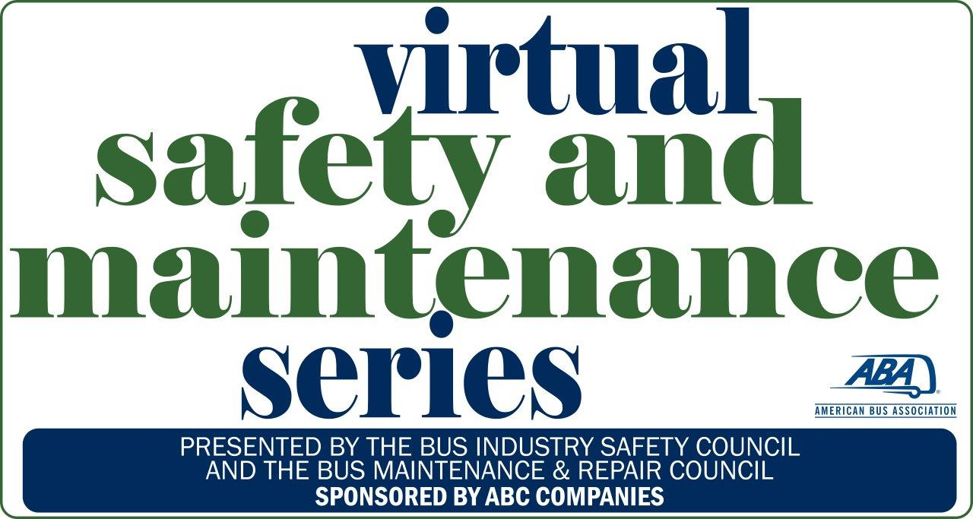
Understanding
Environmental Responsibilities

Slide 2
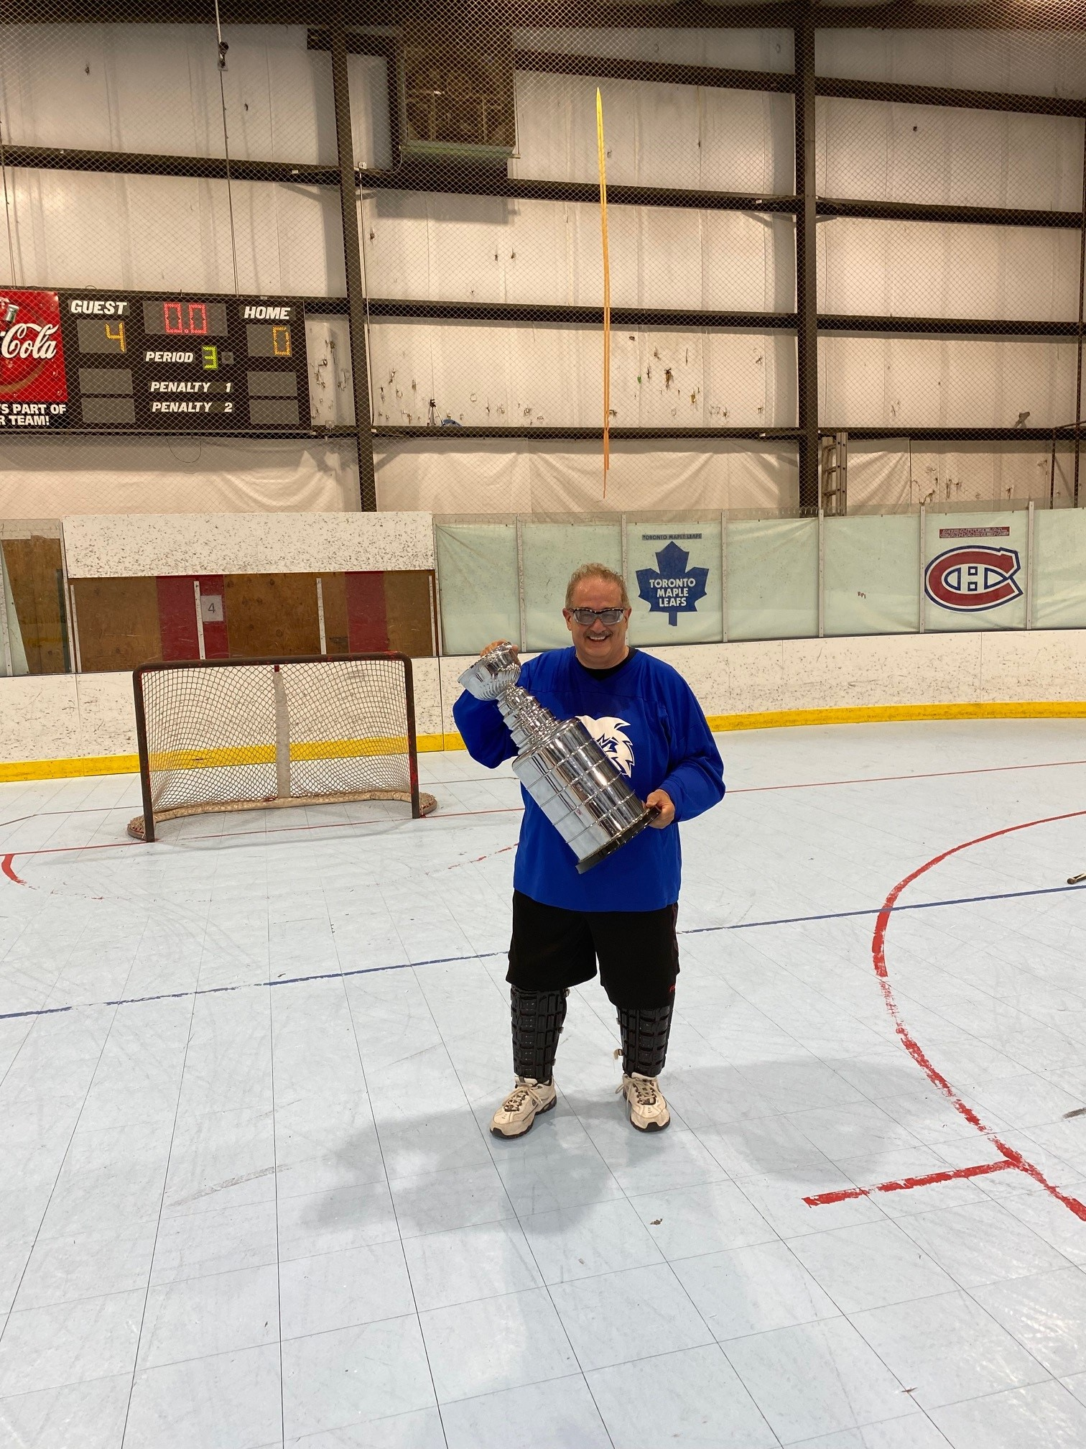

Speaker: Salvatore Caccavale CPEA-EHS
Contact information:
scaccavale@martzbus.com
570-821-3830 (office)
815-302-9185 (cell)

Slide 3
Major Regulatory Areas
Air quality – regulated under Clean Air Act & other laws to control the amount of hazardous materials released into the air people breath.
Water quality – regulated under Clean Water Act, which governs discharges of pollution into surface waters such as lakes, rivers, and streams. A separate law, Safe Drinking Water Act, regulates the quality of water people drink.

Slide 4

Major Regulatory Areas
Waste materials are regulated under Resource Conservation and Recovery Act (RCRA) which deals with waste disposal and recycling. Focuses on proper disposal of hazardous wastes.
Chemical safety & use are regulated under 2 laws.
Toxic Substance Control Act (TSCA) covers hazards of new and existing chemicals.
Federal Insecticide, Fungicide and Rodenticide Act (FIFRA) covers pesticides.

Slide 5
Major Regulatory Areas
Cleanup of waste sites is regulated under the Comprehensive Environmental Response and Liability Act (CERCLA) also known as “Superfund”.
The Emergency Planning and Community Right to Know (EPCRA) deals with emergency planning and chemical information.

Slide 6

You say you want an Evolution!
Rachel Carson
1945 – wrote paper on government over use of chemical pesticides – no one listened
“If man were to follow the teachings of Rachel Carson, we would return to the dark ages and the insects, diseases and vermin would once again inherit the Earth.”
Smear tactics didn’t work!!
1962 – the New Yorker published “Silent Springs”
“Rachel Carson meticulously described how the pesticide DDT entered the food chain in the fatty tissues of animals, including human beings, and caused cancer and genetic damage.”

Slide 7

You Say you want an Evolution!
Environmental Protection Agency (EPA) – 1969
Earth Day (April 22, 1970)
ISO 14001 – Environmental Management System

Slide 8

Clean Water Act
Safe Drinking Water Act - (1974)
set standards for level of contaminants in drinking water, and protected water wells and sole source aquifers
Clean Water Act - (1977) make nation’s waterways “fishable and swim able,” to ban toxic pollution and to eliminate the discharge of all pollution into the Nation’s “navigable waters”

Slide 9
Clean Water Act - Primary Elements
minimal national effluent standards based on specific industries
system of water quality standards
discharge permit program (NPDES) provides enforceable limitations on discharges
provisions for toxic chemical and oil discharges
Examples of regulated effluents are:
water/oil separators
sewerage treatment plants
storm water collection systems
industrial treatment plants (chemical/biological)

Slide 10
Clean Water Act - Oil Pollution
Oil Pollution Act applies to onshore facilities not involved in transportation matters
must prepare a Facility Response Plan if they handle, transport or store oil OR
could cause substantial harm to environment.
Substantial harm - any discharge into the water, shore- line or economic zone around the facility.
Notification to the National Response Center (NRC)

Slide 11
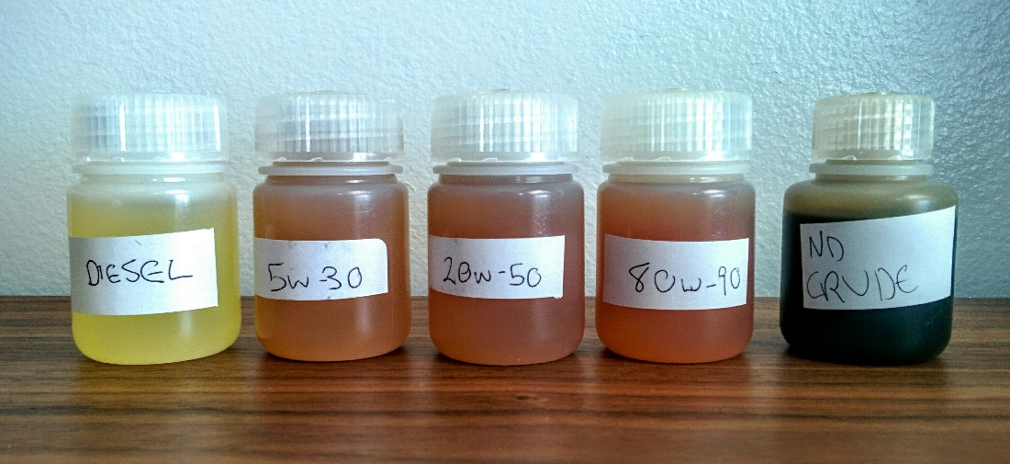
Clean Water Act - Oil Pollution
Oil of any kind in any form, including, but not limited to:
  fats, oils, or greases of animal, fish, and marine mammal origin;
  vegetable oils, including oils from seeds, nuts, fruits, or kernels;
  AND
  oils and greases, including petroleum oil as, crude oil, refined oil, fuel oil, sludge, synthetic oils, mineral oils, oil refuse, or oil mixed with wastes.

Slide 12
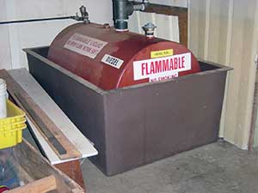
Clean Water Act - SPCC Plan
Spill Prevention Control and Countermeasure (SPCC)
threshold quantity - 1320 gallons aggregate,
containers >55 gallons OR >42,000 UST capacity
reportable spill quantity – >1,000-gallon spill OR two (2) spills 42 gallons within 12 months
storage area must be included in facility diagram
Plan must be reviewed every 5 years
Professional Engineer certification “technical changes”

Slide 13
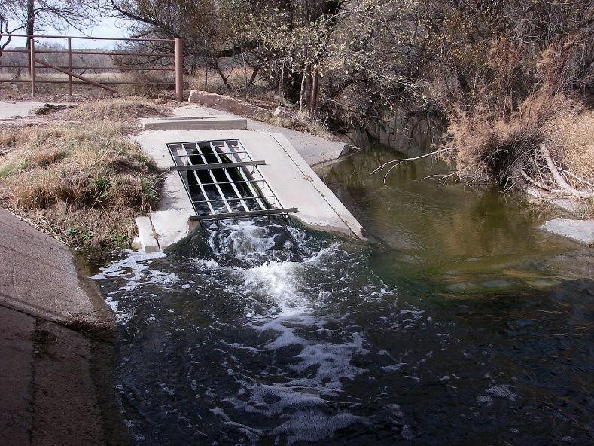
Clean Water Act - NPDES
National Priority Discharge Elimination System
regulates industrial & municipal point source discharges
establishes performance level the discharge maintains
requires discharge to self report any failures
sampling activities required (grab and composite)
discharge monitoring reports (DMR’s)
reportable quantities (RQ’s) hazardous substances (~300)
permit renewed every 5 years

Slide 14
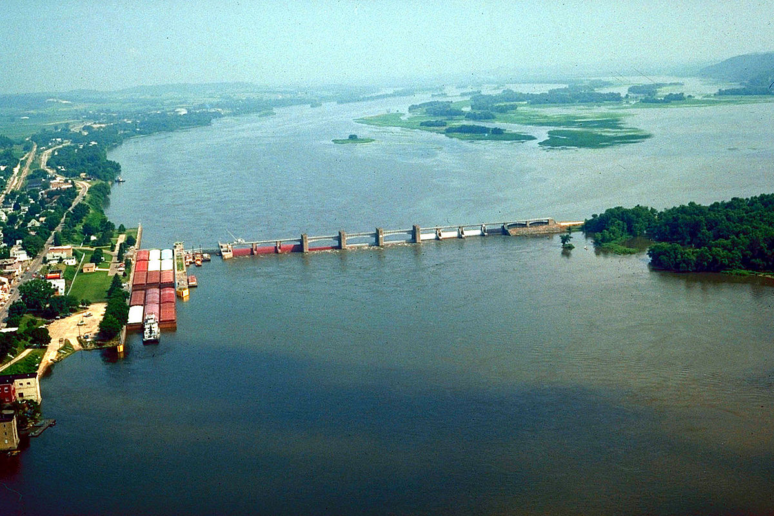
Clean Water Act - Pollutants
Conventional:
Biological Oxygen Demand (BOD)
Chemical Oxygen Demand (COD)
Total Suspended Solids (TSS)
pH
oil and grease
fecal coliforms
Non-conventional: nutrients and phosphorus
Toxic pollutants: organics and metals (65)

Slide 15
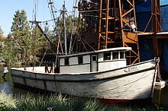
Clean Water Act - Water Quality
Water Quality Standards
Based on the use of the water, such as:
aquatic life support, fish consumption,
shellfish harvesting,
drinking water supply,
swimming, recreational, wildlife habitat
Criteria set to protect and maintain designated use for water body
Numeric - physical, biological and chemical parameters
Narrative - defines rather than quantifies conditions and goals

Slide 16

Clean Water Act - Pretreatment
Industrial waste-water not directly discharged into water ways go to a Publicly Owned Treatment Works (POTW) must partake in a pretreatment program (chemical & biological)
permits issued from municipality
slug plan is usually required

Slide 17
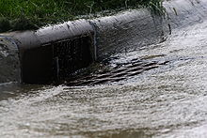
Clean Water Act - Storm Water
What is Stormwater?
Stormwater is rain or snowmelt that doesn’t soak into the ground and runs off into waterways.
As it flows over paved and unpaved areas, it picks up potential contaminants (e.g., oils, sediment/dirt, chemicals).

Slide 18
Clean Water Act - Storm Water
Point Source Discharges - storm water associated with industrial facilities
Individual or general permit conditions:
periodic sampling (annually) & analysis
development of Storm Water Pollution Prevention Plan
Non-Point Sources - runoff from farm fields, city streets and construction sites (salt, silt, pesticides)

Slide 19
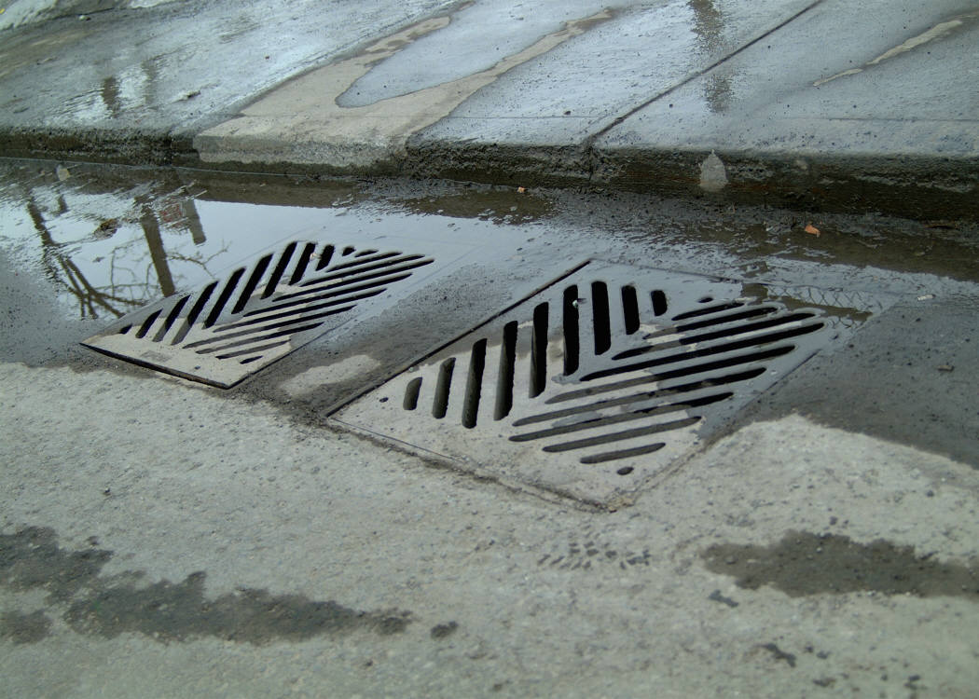
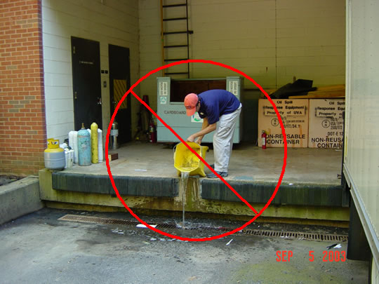
Storm Water BMP’s
Good housekeeping
  Keep your work area neat and orderly
  Keep unused containers closed tightly
  Use a drip pan when pouring
2. Materials management
Store materials out of the weather
Cover them temporarily
Load/Unload out of the weather
3. Spill Response
NEVER hose down a spill
Prompt “dry” clean-up of spills
Protect storm drains - hay bales/socks
Dispose of clean-up wastes properly
Notes:
Good housekeeping is the key to any environmental program. Unused chemical and oil containers should be closed tightly when not in use. You should always use a drip pan when transferring from one container to another.
If possible you should store materials, chemical bags, drums, etc. out of inclement weather if at all possible. At the very least they should be covered and stored in an area with secondary containment. You should always load and unload bags, drums, etc. out of the weather if possible.

Slide 20
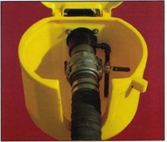
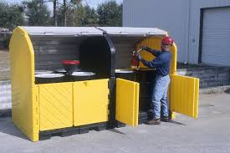
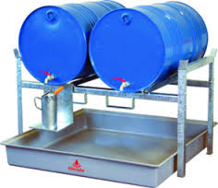
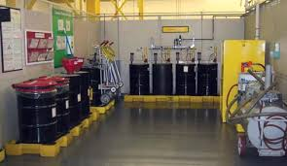

Slide 21
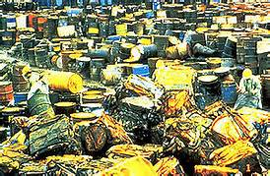
What led to RCRA?
Industrial Revolution – acceptable dumping practices
Energy crisis of 1973/1974 (concerns about resource conservation and recovery)
Leaking landfills contaminate drinking water supplies
Incidents
  Times Beach, MO
  Love Canal, NY

Slide 22
History of RCRA
Solid Waste Disposal Act (SWDA) of 1965
Resource Conservation and Recovery Act (RCRA) of 1976
Hazardous and Solid Waste Amendments (HSWA) of 1984
Federal Facility Compliance Act (FFCA) 1992
Land Disposal Program Flexibility Act of 1996
HW Generator Improvements Rule (5/30/2017)
Authorized states had to adopt more stringent rules by 7/1/2018
Minimize generation of hazardous waste by encouraging:
  process substitution
  materials recovery
  properly conducted recycling and reuse treatment
Notes:
HW generation pre-WW II was 1/2 million tons/yr; by 1981 had grown to 264 million tons/yr - 500X increase.
SWDA - First federal law requiring safeguards and encouraging sound disposal - addressed primarily nonhazardous solid waste. Gave states the responsibility for solid waste management plans.
Resource Recovery Act of 1970 amended SWDA to include EPA funding for resource recovery provisions, but had little practical effect on waste management practices in the U.S.
RCRA 1976, which amended and replaced SDWA entirely. First to meaningfully address hazardous waste (in Subtitle C), and also addressed nonhazardous solid waste (in Subtitle D) as well as resource recovery
EPA was slow to issue regs. Initial regs issued May 1980, effective November 19, 1980. By 1984, only 5 disposal facilities were permitted. Land disposal still preferred. Threat to GW remained.
HSWA significantly expanded RCRA to include highly prescriptive requirements related to land disposal, design standards for land-based units (MTRs), UST program, corrective action program
FFCAct - Provides temporary relief to DOE from LDR storage prohibition for management of mixed waste and extends domestic sewage exclusion to FOTWs.

Slide 23
Where are the RCRA Rules Found?
RCRA - federal program defines/sets standards for hazardous waste activities of generators, transporters, and TSD facilities.
40 CFR Part 260 through 282 and 148

Slide 24
Main Components
Identification of hazardous waste
Manifest tracking - “Cradle-to-Grave”
Operating standards for generators, transporters, and treatment, storage, and disposal facilities
Permit system for TSDFs
State authorization to assist in implementing program

Slide 25
Generator Standards
RCRA sets standards for generators to include:
Hazardous waste identification
EPA ID number
Proper storage of waste (container and tank requirements)
Packaging and labeling requirements
Manifest requirements
Accumulation storage area inspections
Personnel training
Contingency plan and emergency procedures
Preparedness and prevention
Waste minimization
Recordkeeping

Slide 26
Treatment, Storage and Disposal Facility
Any person who treats, stores or disposes of hazardous waste is considered a TSDF – need approval feds/state
Disposal facility is defined as facility (or part) at which hazardous waste is intentionally placed, and will remain after closure
Activities are regulated as "disposal" if a facility is used for:
  Discharge, deposit, injection, dumping, spilling, leaking, or placing of any solid or hazardous waste into or on any land or water such that waste or constituents may enter environment, including air and waters

Slide 27
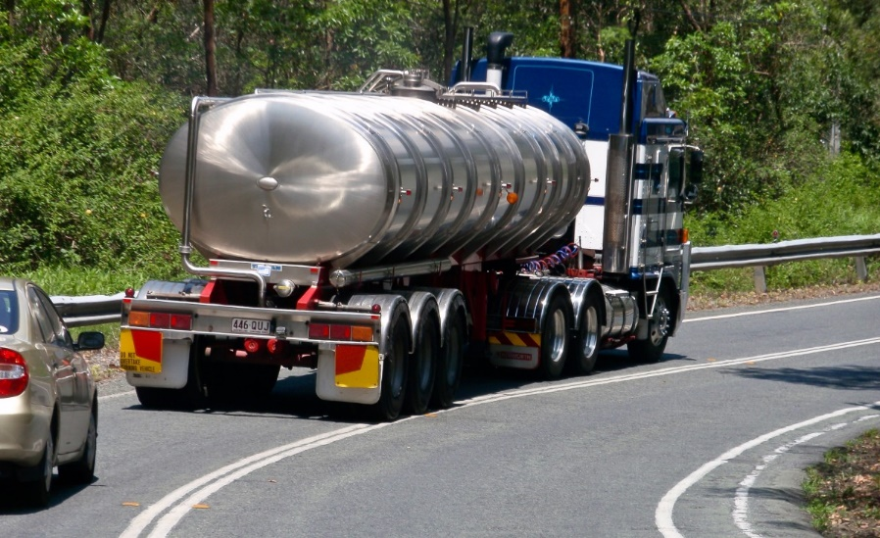
Transporter
Comply with Federal RCRA (delivery, clean-up, spill reporting)
Licensed (States)
DOT requirements (driver quals, hazmat training, insurance)
Accept waste in accordance with manifest system
Maintain copy of manifests for minimum of 3 years
Transfer facilities store waste in containers no greater than 10 days

Slide 28
Generator Classifications
Very Small Quantity Generator
  Conditionally Exempt Small Quantity Generator
Small Quantity Generator
Large Quantity Generator
  Episodic Events (1X year)

Slide 29
Very Small Quantity Generator (VSQG)
< 100 kg (220 lbs.), and <1 kg (quart) /calendar month acute
Maximum accumulation: 1000 Kg (2200 lbs.)/no time limit
Identify all hazardous wastes
Send waste to a hazardous waste facility
  Allow VSQG to ship waste to LQG under control of same person
Small Quantity Generator (SQG)
100 - 1000 kg/calendar month and < 1 kg/month acute
Maximum accumulation: 6000 kg (13,228 lbs.)/180 days (270)
3010 notification and EPA Identification Number
Container and tank standards
Preparedness and prevention/emergency coordinator
Employee training
Manifesting
Must resubmit notification every two years (2/1 on even years)

Slide 30
Large Quantity Generator (LQG)
>1000 kg/calendar month, or >1 kg/month acute
Maximum accumulation: No limit/90 days
Written Contingency Plan
Written training program/job descriptions
Control of air emissions
Comply with ALL hazardous waste rules
Acute hazardous wastes are those wastes that, in small doses, are capable of causing death or significantly contributing to irreversible and/or incapacitating illness (e.g., dioxins)
Must resubmit notification every two years (3/1 on even years) with biennial report

Slide 31
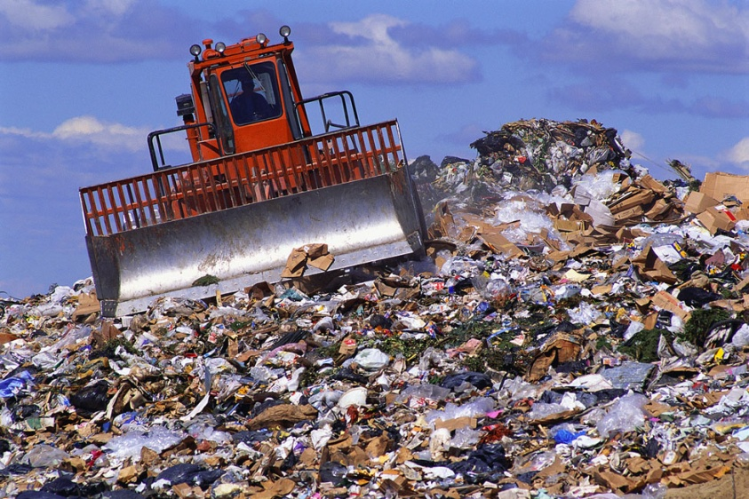
What is a Solid Waste?
Garbage, refuse, sludge and other discarded material
Can be a solid, liquid, semi-solid or contained gaseous material
A waste MUST be a Solid Waste BEFORE determined as Hazardous Waste!

Slide 32
RCRA defines a Solid Waste as a Hazardous Waste if it:
Is Specifically Listed - F, K, P, and U Series or has Certain Characteristics - D Series
Is a "Mixture" of Listed Hazardous Waste and Non-Hazardous Waste
Listed hazardous waste “Contained In” soil or other environmental media
Is "Derived-From" treatment of hazardous waste
Is Declared as Such by the Generator “accurately”

Slide 33
Types of Listed Hazardous Waste
F - Nonspecific Sources: Acetone F003 (I)
K - Specific Industrial Sources: (K001 - K151)
Toluene DiAmine (TDA) Production - K113 (T)
P and U series - discarded commercial chemicals
P - Acute Hazardous Waste: Phosgene P095 (T)
U -Toxic Hazardous Waste: Toluene Diisocyanate (TDI) U223 (R,T)

Slide 34
Characteristic Hazardous Waste
A waste is considered a characteristic hazardous waste if it exhibits one (1) or more following characteristics:
Ignitability D001 (Paint, Dimethylformamide)
Corrosivity D002 (Sulfuric Acid)
Reactivity D003 (Silane)
Toxicity Characteristics D004 through D043 (40 Chemical Constituents)

Slide 35
Ignitability (D001)
Liquid - Flash point <140 Degrees F (60 C)
Non-liquid - Capable, under STP, of causing fire through friction
  Ignitable compressed gas (DOT 49 CFR 173.300)
Oxidizer (DOT 49 CFR 173.151)
Corrosivity (D002)
Aqueous and has a pH < 2 OR > 12.5
Liquid & corrodes steel at rate >0.25 inches per year at 130F
Reactivity (D003)
Unstable/undergoes violent change (organic peroxides, silane)
Violently water reactive/explosive certain metals - sodium

Slide 36
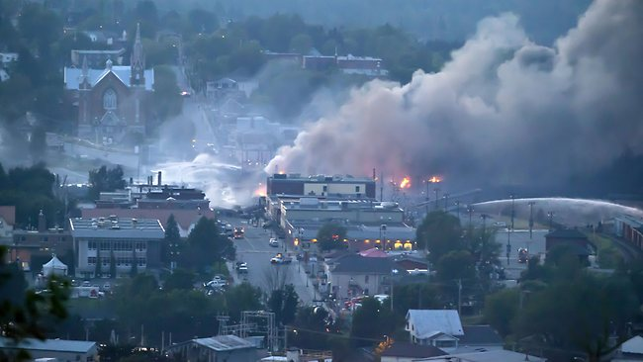
Toxicity (D004 - D043):
A waste may be a toxicity characteristic waste if any of the chemicals listed are present in the waste sample extract, resulting from the application of the TCLP to the waste, in excess of the regulatory limit. (Method 1311)
The 40-toxicity characteristic waste chemical constituents consist of:
  8 insecticides and herbicides
  8 metals
  24 organics

Slide 37
EPA
Code Contaminant mg/L
D004 Arsenic 5.0
D005 Barium 100.0
D006 Cadmium 1.0
D007 Chromium 5.0
D008 Lead 5.0
D009 Mercury 0.2
D010 Selenium 1.0
D011 Silver 5.0
D012 Endrin 0.02
D013 Lindane 0.4
D014 Methoxychlor 10.0
D015 Toxaphene 0.5
D016 214-D 10.0
D017 2,4,5-TP(Sivex) 1.0
D018 Benzene 0.5
D019 Carbon Tetrachloride 0.5
D020 Chlordane 0.03
D021 Chlorobenzene 100.0
D022 Chloroform 6.0
D023 o-Cresol 200.0
EPA
Code Contaminant mg/L
D024 m-Cresol 200.0
D025 p-Cresol 200.0
D026 Cresol 200.0
D027 1,4-Dichlorobenzene 7.5
D028 1,2-Dichloroethane 0.5
D029 1, 1 -Dichloroethylene 0.7
D030 ,4-Dinltrotoluene 0.13
D031 Heptachlor (and its. hydroxide) 0.008
D032 Hexachlorobenzene 0.13
D033 Hexachloro-1,3-Butadiene 0.5
D034 Hexachloroethane 3.0
D035 Methyl Ethyl Ketone 200.0
D036 Nitrobenzene 2.0
D037 Pentachlorophenol 100.0
D038 Pyridine 5.0
D039 Tetrachloroethylene 0.7
D040 Trichloroethylene 0.5
D041 2,4,5-Trichlorophenol 400.0
D042 2,4,6-Trichlorophenol 2.0
D043 Vinyl Chloride 0.2

Slide 38
Waste Examples
Process Generating Waste EPA Code
Paint which contains MEK D001 (I); D035 (T)
Contaminated MEK U159 (I, T); D001 (I)
(raw material)
Solvent mixture used F005 (I, T); D001 (I)
in process cleanup

Slide 39
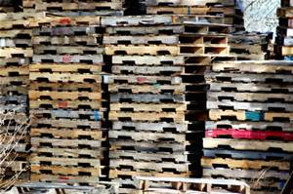
Contained In Rule
Originally developed as policy regulating contaminated areas
Applies to soil, groundwater & sediment contaminated by listed hazardous waste
Media contaminated by a listed waste must be managed as listed waste
Contained-In Policy applies to:
  Contaminated laboratory equipment
  Contaminated pallets
  Dismantled scrubber components
  Fluidized bed media
  Spent carbon from fume treatment
  Incinerator refractory
  PPE

Slide 40

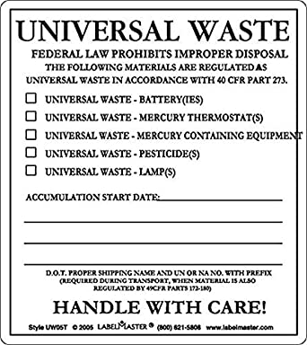
Universal Waste
encourages recycling of the designated wastes both by industry and retail establishments
covered universal wastes
  hazardous waste nickel-cadmium and other batteries (lead-acid)
  pesticides recalled or collected in a waste pesticide collection program
  mercury-containing thermostats
  fluorescent bulbs
  electronics (state by state)

Slide 41
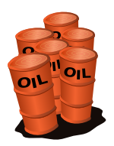
Used Oil
Used Oil if it is recycled or reclaimed does not have to be managed as a hazardous waste if it meets specific conditions:
Includes any oil refined from crude oil or any other synthetic oil contaminated by chemical or physical impurities.
Is not mixed with any listed hazardous waste.
Contains less than 1,000 ppm total halogens.
Does not exhibit a hazardous waste characteristic.
NOTE: Proper Federal terminology for labels and/or markings on containers and tanks is “Used Oil.”

Slide 42
On-Site Accumulation
Large Quantity Generators
Accumulate Hazardous Waste On-site Up to 90 Days provided:
  The Waste is Placed in Containers or Tanks
  The Accumulation Start Date is Clearly Marked and Visible On Each Container
  Each container or Tank is Marked: "Hazardous Waste"
  Preparedness and Prevention
  Contingency Plan and Emergency Procedures
  Training

Slide 43
Satellite Accumulation Area:
  Volume limitation of 1 qt P-listed or 55 gallons of hazardous waste
  At or near point of generation under control of process operator
  One satellite area per waste stream at each point of generation
  No limit as to how long the waste can accumulate
Central Accumulation Area:
  No volume limitation
  No requirement to be at or near the point of generation
  Storage time is limited to 90-days
  No limit as to the number of 90-day accumulation areas

Slide 44
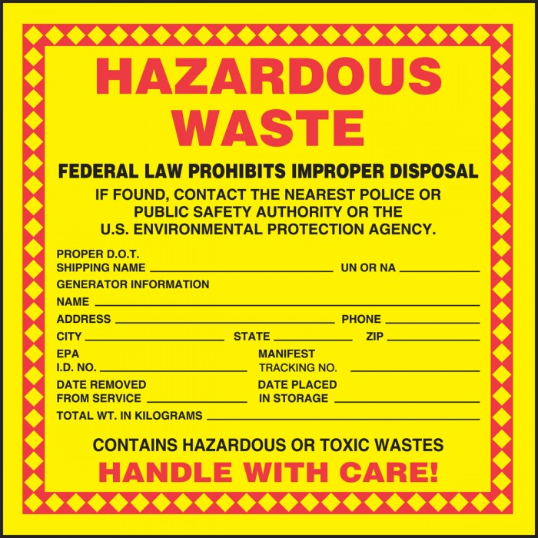

Shipping & Manifesting Requirements
Uniform Hazardous Waste Manifest (e-manifest)
  Must accompany all hazardous shipments and in some state's certain non-hazardous wastes
  Must include Land Disposal Restriction paperwork for hazardous waste
  ERG guide page if driver does not have book
Labeling and Marking
  Hazardous waste marking (yellow label)
  DOT label (i.e., corrosive, flammable)

Slide 45
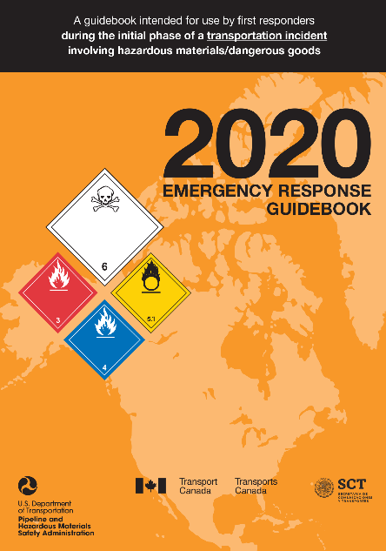
Completion of Manifests
Manifest must include the following information:
Generator, Transporter, and TSDF Information
DOT Description of Waste
Quantity of Waste
EPA/State Waste Code
Emergency Response Information
  ERG Guide Number
  24 Hour Phone Number (i.e., CHEMTREC 1-800-424-9300)
Certification: Waste Minimization

Slide 46
RCRA Contingency Plan
Applicability - 90-day generators/TSDFs
Required Contents
  Describe facility response to spills, fire, explosions, or any unplanned sudden or non-sudden release
  Describe arrangements with ER agencies (i.e., police, fire, hospitals)
  List ER coordinators in order - names, addresses, phone numbers
  List of ER equipment - physical description, location, capabilities
  Evacuation plan
Plan MUST include “Executive Summary”
Preparedness and Prevention
Minimize the likelihood of an accident due to hazardous waste management activities

Slide 47

Employee Training
Who must be Trained?
All personnel involved in hazardous waste management (except satellite accumulation)
  Small quantity generators
  <90-day generators
  TSDF facilities
When in doubt, TRAIN !!!

Slide 48


criminal acts under RCRA carry severe Penalties.
1) Transporting waste to a non-permitted facility
2) Treating, storing or disposing of waste w/o a permit
3) Omitting information/false statement on any compliance document
4) Not complying with recordkeeping and reporting requirements
5) Transporting without a manifest
6) Exporting waste without consent of receiving country
7) Action resulting in imminent danger
$50K/day of violation and two years in prison
$100K/day and four years in prison (repeat offenses)
$250K/day and 15 years in prison for an individual or
$1M for organization (applicable to act (7) only)

Slide 49
COMMON MISTAKES
Not covering/closing containers
Incorrect container labeling
Improper use or missing accumulation start date
Exceeding the three-day (72 hours) time limit for full satellite containers
Improper training documentation
(i.e., job descriptions, titles/qualifications, frequency)
Failure to conduct inspections
Failure to update contingency plan

Slide 50
Clean Air Act (CAA)
CAA of 1970
  National Ambient Air Quality Standards (NAAQS)
CAA of 1990
  established Titles III, V, VII

Slide 51
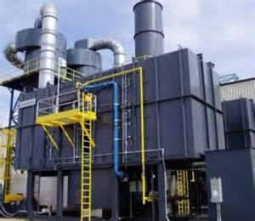
Title III CAA
Hazardous Air Pollutants (HAPS) – 189 established
Maximum Achievable Control Technology (MACT)
Minor Source > 10 Tons/Year for 1 HAP
Major Source > 25 Tons/Year for combination
Control technologies identified - all HAP’s

Slide 52
Title V CAA
Created New Federal /State Permitting System
Nationwide system of fees @ $25/Ton
Minimum tonnage levels for regulated pollutants established for inclusion in permits
Long lead time for approval
States manage program with Federal oversight
Title VII CAA
Enforcement authority established
Criminal and Civil Penalties
Maximum $25K/day per violation
Maximum Administrative penalty $200K

Slide 53
NAAQS CAA
Established for six criteria pollutants
Nitrogen Oxide (NOX)
Sulfur Dioxide (SOX)
Carbon Monoxide
Ozone
Lead
Particulate Matter
Attainment vs. non-attainment areas
New Source Performance Standards (NSPS)
NSPS reviews impact to areas not just a state

Slide 54
Comprehensive Environmental Response, Compensation and Liability ACT (CERCLA)
History - passed by Congress in 1980
CERCLA - Provide mechanism for response to cleanup activities
  Accidental Spills & Abandoned Sites
3 Basic Responses - Removal; Remedial Actions; Enforcement
Goal of CERCLA - Primary Responsible Party (PRP)
PRP to pay for Cleanup
Fed’s pay and pursue PRP’s

Slide 55
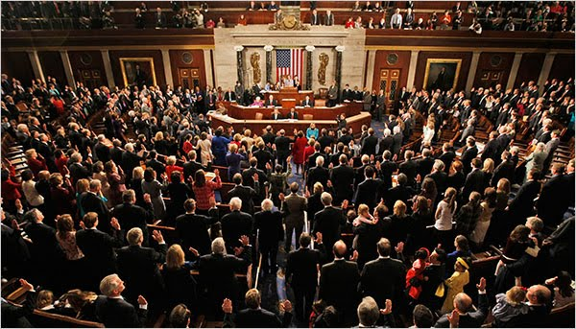
Superfund Amendment & Reauthorization Act (SARA)
Five Titles
Title III Emergency Planning & Community right to know (EPCRA)

Slide 56
EPCRA
Result of Bhopal India Incident
Nationwide Program for emergency planning and reporting
Five (5) areas of EPCRA:
Emergency Planning
Emergency notification/release reporting
Community Right to Know
Toxic Release Reporting (Form R)
Miscellaneous provisions

Slide 57
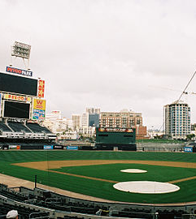
Community Right to Know
Linked to OSHA’s HazCom (GHS) Standard
Manufactures/Importers of Hazardous Chemicals
SDS’s to SERC/LEPC and Fire Department
Annual inventory of Chemicals
Tier I & Tier II
Due by March 1st of each year

Slide 58
Tier I
Aggregate of all chemicals
Estimate Average daily amount at Facility
General Location of Chemicals
Tier II
Chemical Specifics
CAS Number/State of chemical
Number of days chemicals on site
Specific Storage Locations

Slide 59
What is an Environmental Incident?
Administrative
Non-approved chemical use
Missed report/deadline
Missed sampling event
Manifest timing
Unintentional Releases
Spill
Excess emission/discharge
Improper disposal of waste
Incorporate into safety reporting system
Include internal and external (3rd party/contractors)
Establish environmental “near miss” criteria
Best Practices:
Routinely review records (process logs, pm records)
Develop notifications at limits prior to NOV

Slide 60

What we for?
Puddles and liquids in unusual places
Dust or oily film on equipment or the ground
Residue on containers or piping
Discolored plumes from air control equipment
Inspection Programs
Storm Water Inspections (SWPPP)
Spill Prevention Countermeasure and Control (SPCC)
RCRA Satellite and Storage Area Inspections
Equipment Inspections (Preventive Maintenance)

Slide 61
Environmental Program Development
Review all permits, regulatory requirements
Thoroughly read & understand each permit/regulation
    contact Company resources/regulatory agencies
What are permits/regulatory requirements?
Recordkeeping
Reporting
Sampling/Monitoring
Inspections
Training
Benefits:
Standard Practice
Responsibilities delegated
Info available always
Change Management
Continuous Improvement

Slide 62

Safe Travels…

