Slide 1
Technology and Your Business
September 27th 2:00 ET

Slide 2
Created by the ABA's Women in Buses Council, Driving Force is a program designed to tackle the nationwide driver shortage by providing industry operators tips and tools to recruit and retain their most valuable asset: Drivers

Slide 3
Agenda
Overview of the Driving Force and available tools
Guest Speaker: Athena Grimm
Technology and Culture
Chat GPT overview and business examples
Questions

Slide 4
Who is behind the Driving Force?
James Blain, PAX Training
Erin Ducharme, Bloom’s Bus
Adam Hall, Bridgestone Fleet Care
Brent Maitland, MCI
Pam Martinez, DATTCO
Mike McDonal, Saucon Technologies

Slide 5
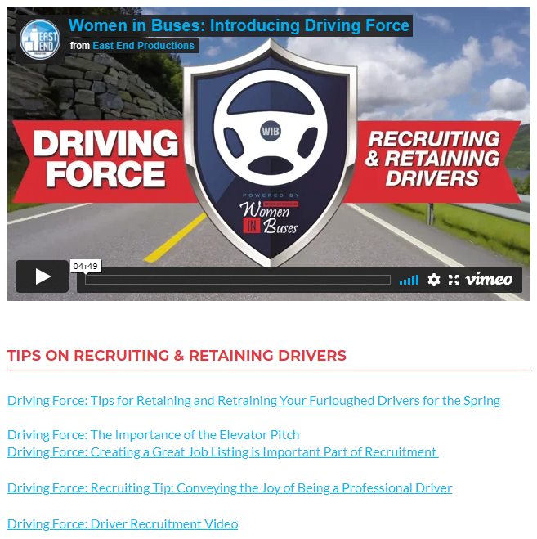
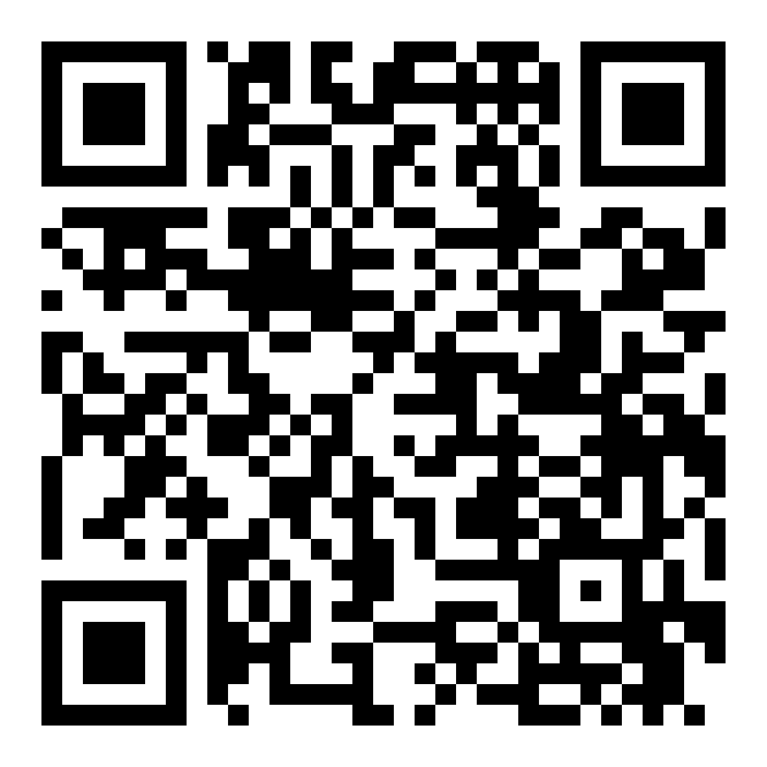
Where is the Driving Force?
The Force is Always With You
buses.org/drivingforce

Slide 6
Steps to prepare for recruiting and retention
Review the roadmap and toolkit
Customize to your company
Engage leadership
Culture Check (See right)
Culture is Critical
Develop & showcase your company values
Show employees you care
Treat employees fair and with respect
Provide a safe work environment
Maintain a positive perception of the Company in the Community
Roadmap for Recruiting & Retention
RECRUITING
RETENTION
The Recruiting and Retaining Roadmap will Enhance Your Most Valuable Assets – Drivers!
Notes:
Where we bega

Slide 7
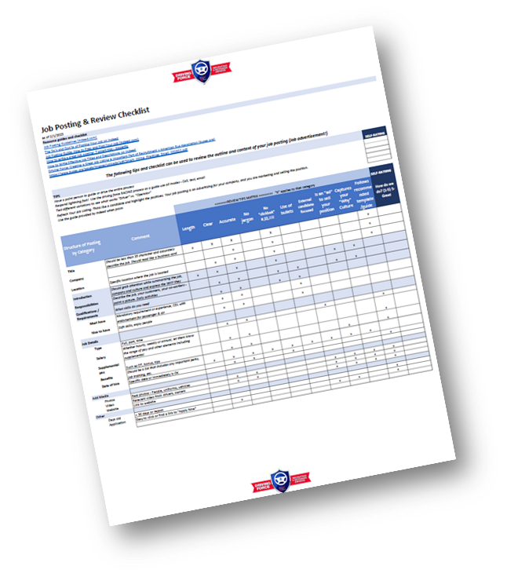
Tools are Free to Use
buses.org/drivingforce

Slide 8
Athena Grimm

Slide 9
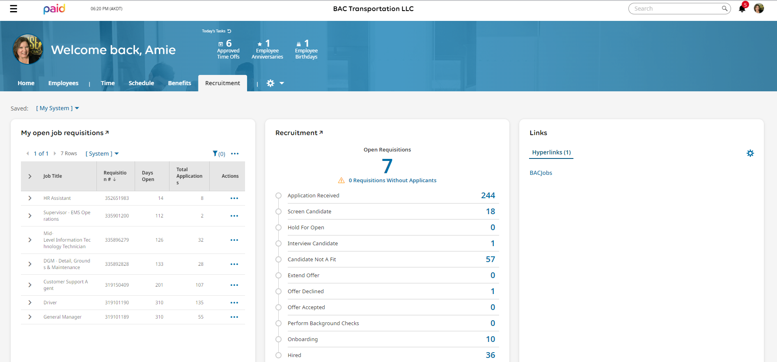
HR Dashboard

Slide 10
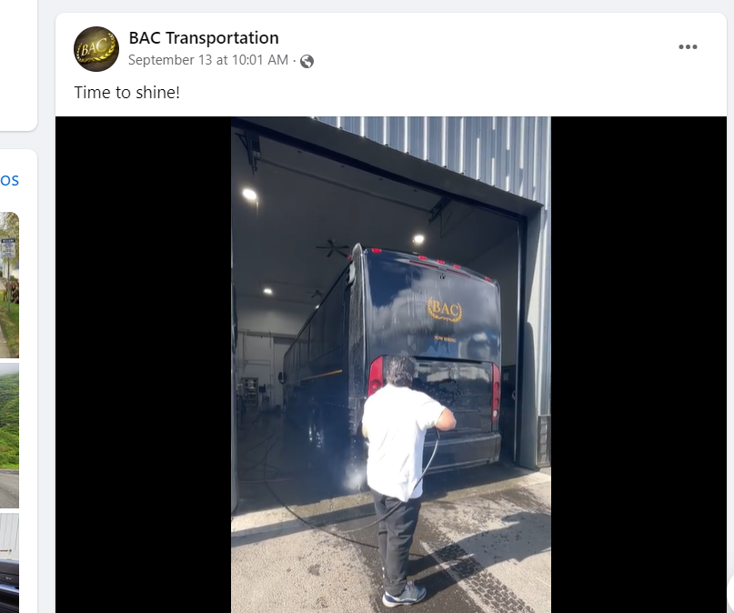
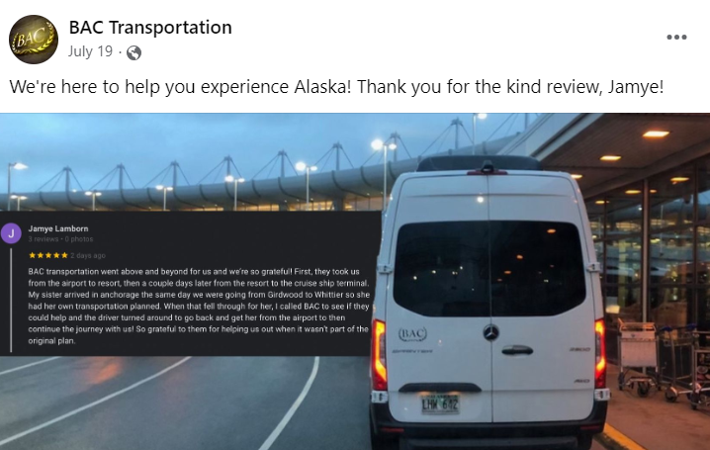
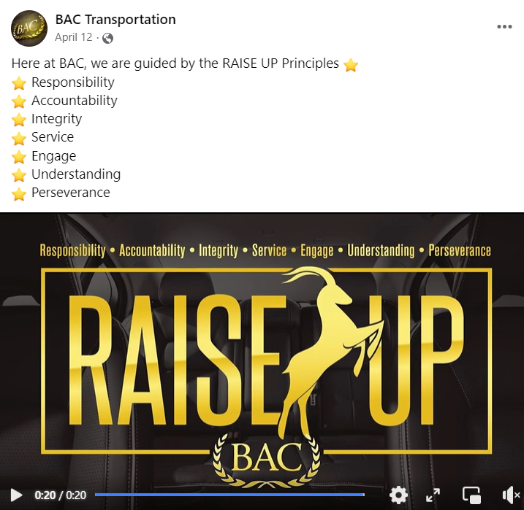
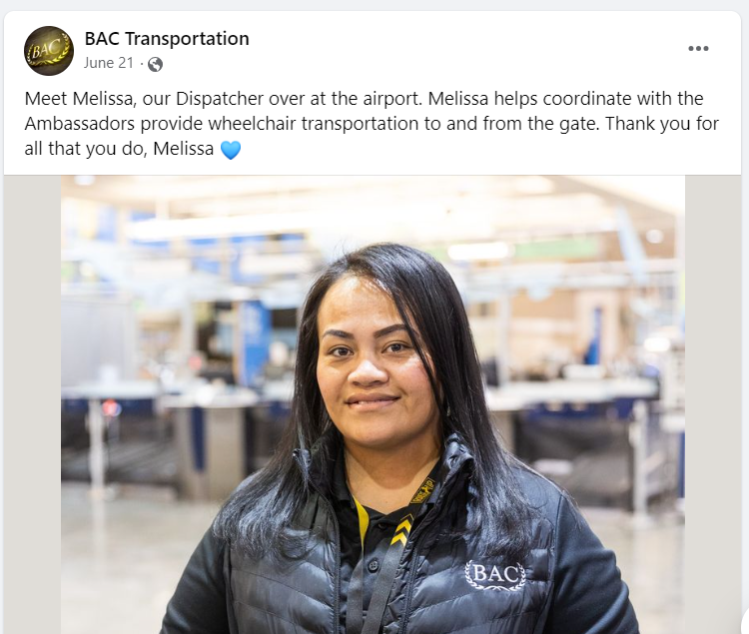
Online Branding

Slide 11
Technology and Culture
How you can use it to express your company culture?
Gamify company culture initiatives: Utilize gamification techniques by creating online games, challenges, or competitions that promote and reinforce your company culture. This not only encourages active participation but also makes it fun and engaging for employees to learn and embrace the desired culture.

Slide 12
Technology and Culture: Onboarding
How to use it for onboarding?
Online Application
Create a company intranet
Use online platforms or e-learning modules to introduce new hires to your company's culture and values during the onboarding process.

Slide 13
Technology and Culture: Retention
Ideas on using Technology:
App for Payroll
Benefit Enrollment
Build Auto tipping into contracts
Bidding, driver assignments and paperwork
Continuing education and rewards
Tracking birthdays, important dates and anniversaries
Electronic logs
Use Technology to encourage safe driving
Compliance- preventing a driver from being out of service, driver files, license renewals

Slide 14
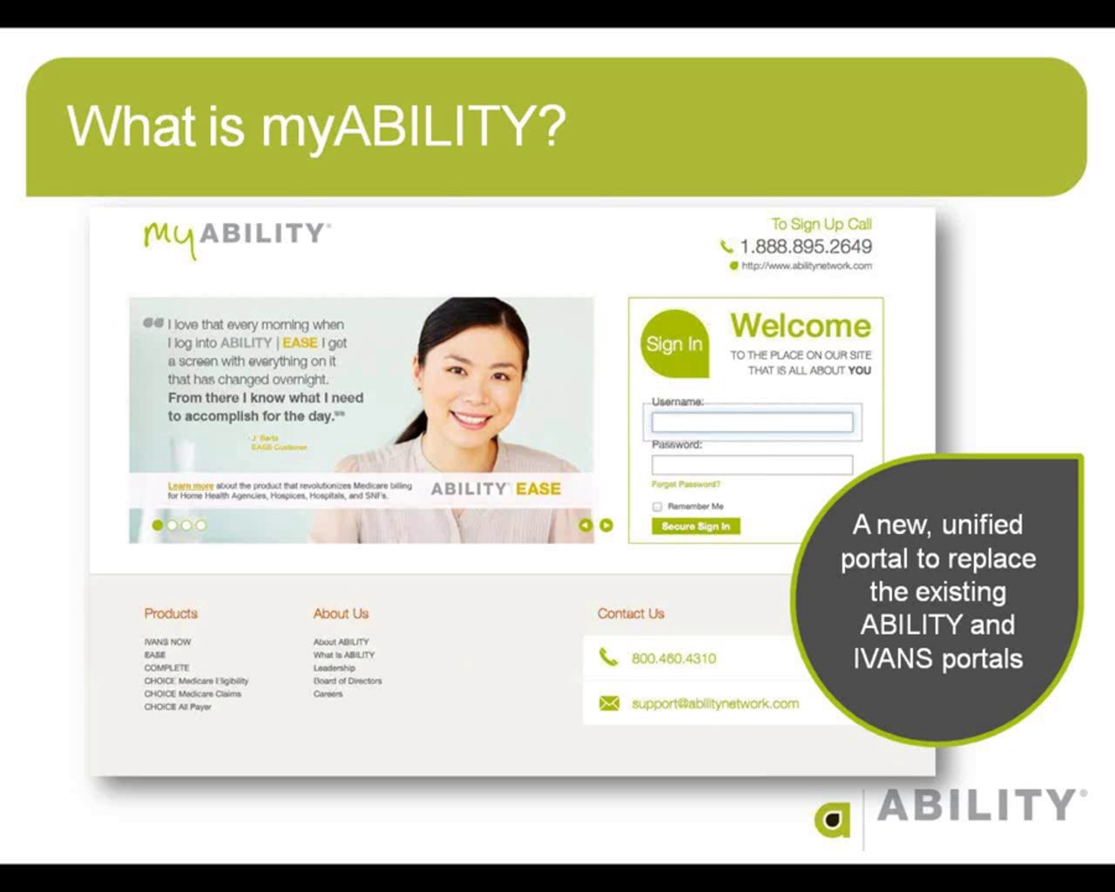
Technology and Culture: Retention
Use employee feedback and survey tools: Leverage technology to collect feedback and insights from employees through online surveys or feedback tools
Conduct stay interviews and exit surveys: Utilize technology to administer stay interviews and exit surveys to understand employee motivations, satisfaction levels, and areas for improvement. Collecting feedback through these channels can help identify and address retention issues proactively.
Implement performance management software that allows managers and employees to track goals, provide feedback, and have regular performance check-ins. This facilitates ongoing communication, recognition, and development, leading to increased employee satisfaction and retention.

Slide 15
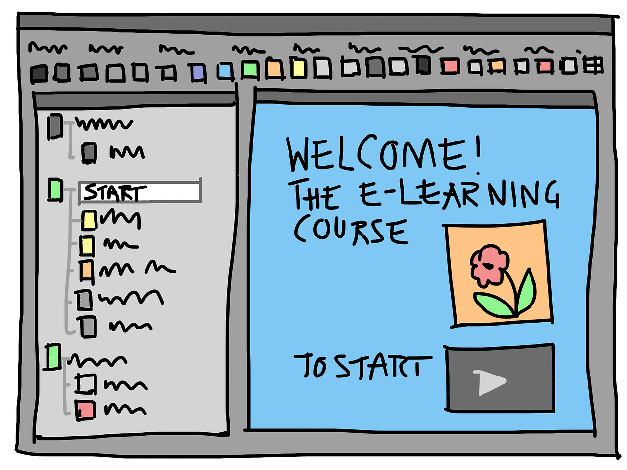
Technology and Culture: Retention
Use internal communication tools: Utilize tools like texting, emails, instant messaging platforms, and internal social networks to regularly communicate and reinforce your company's values, goals, and mission to your employees. Share updates, success stories, and upcoming events to keep everyone informed and engaged.
Use video conferencing: Organize regular virtual meetings or town hall sessions where leaders can address the entire company and communicate the company's culture and vision. Encourage open dialogue, questions, and discussions to foster a sense of belonging and engagement
Provide remote access to company resources: Implement cloud-based systems and tools that allow employees to access company resources and information remotely. This fosters a sense of unity and involvement, even for remote or distributed teams, by giving them access to the same resources and information as on-site employees.
Provide e-learning and development opportunities: Implement online learning platforms or Learning Management Systems (LMS) to offer employees access to training and development resources. This helps them acquire new skills, grow professionally, and feel invested in their career progression within the company.

Slide 16
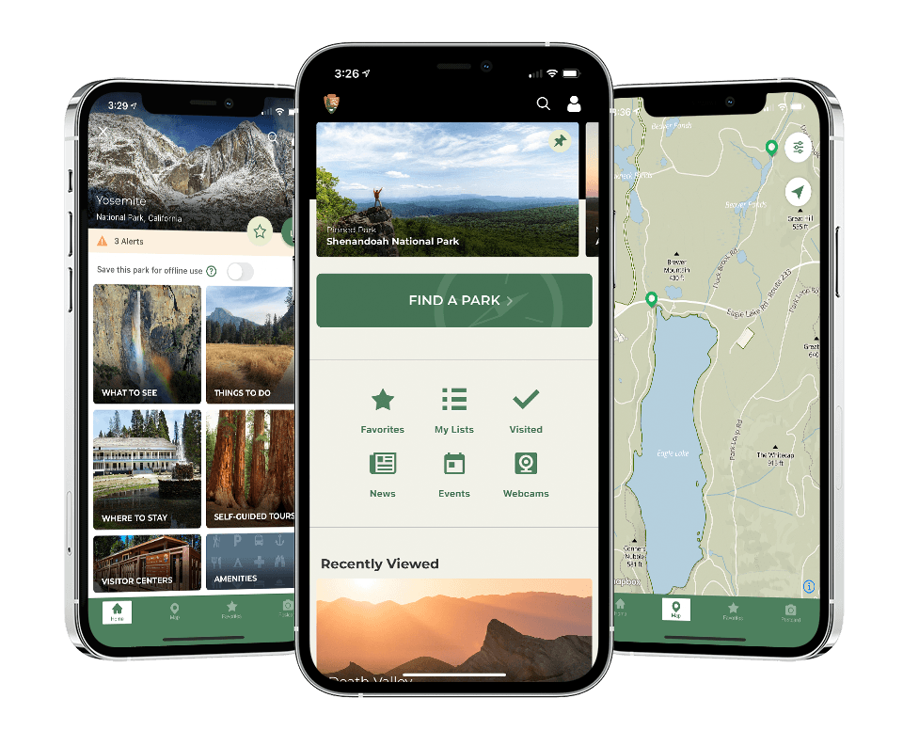
Using Technology To Make You Unique
Technology can be used to showcase your uniqueness. Use your company website to stand out from the competition.
Use multimedia content: Incorporate videos, podcasts, and infographics to visually communicate and reinforce your company culture. These formats can be easily shared and have a greater impact on audiences, helping them better understand and connect with your culture.
Implement wellness and engagement apps that offer features like fitness challenges, mental health resources, and virtual team-building activities. These apps can help improve employee well-being and foster a sense of connection, leading to higher retention rates.
Also consider company provided technology like GPS directions and other daily driver functions that they can access from one technology source.

Slide 17
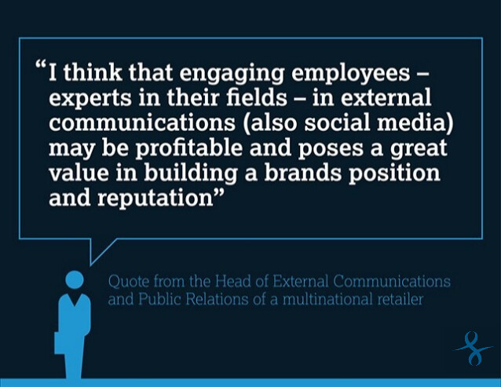
How Technology Can Help You Spread Company Culture
Create a company blog: Start a blog where you can regularly publish articles and stories that reflect and celebrate your company culture. Share employee spotlights, team achievements, and company events to showcase your culture to both employees and external audiences.
Encourage employee-generated content: Empower employees to share their experiences and perspectives on platforms like social media, blogs, or internal communication channels. Have contests where employees can win a prize based on submissions.

Slide 18
ChatGPT is an advanced computer program designed to have conversations with humans. It uses a technology called "natural language processing" which helps it understand and respond to human language just like a person would. It has been trained on a lot of text from the internet to learn how to answer questions, provide information, and even engage in interesting discussions. It can chat about a wide range of topics and tries its best to provide helpful and accurate responses. However, it's important to remember that ChatGPT is still a computer program and may not always provide perfect answers or fully understand context.

Slide 19
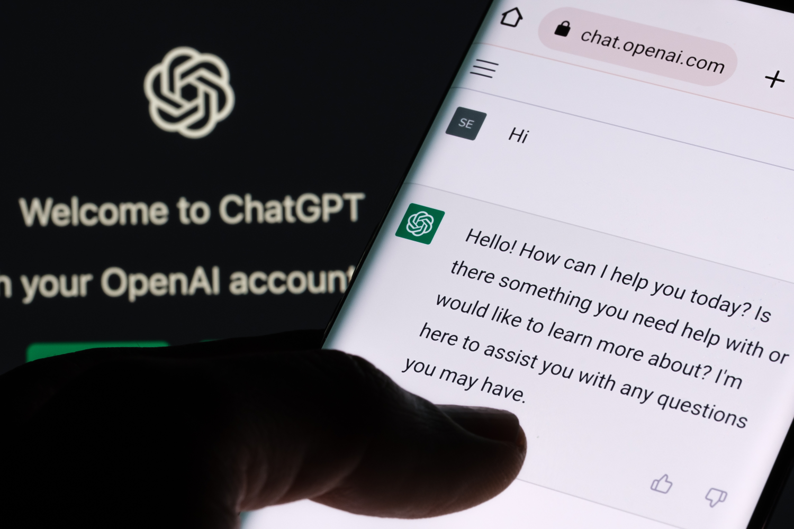
What Is ChatGPT – Without the jargon?
The most advanced chatbot publically available today
A writer
A personal assistant
Someone to talk to about situations or ideas
A computer program that can answer most questions, and even ask you questions to come to conclusions and create new things.
A second eye to look over or reword texts or emails you plan to send.

Slide 20
How does chatGPT actually work?
Based on a large base of data that was compressed into a model
One-to-one prompt response model
Free & Paid versions
ChatGPT 3 & ChatGPT 4
With and without plugins that can pull in extra data
There are also alternatives such as Google’s Bard, Jasper and others some of which are more tailored to specific tasks

Slide 21
Important Things To Consider When Using Chat GPT
Not a person – but acts like a person that will have a 1-to-1 text conversation with you
Limited in currently data (2021) and earlier – unless using plugins or giving it additional data
May give incorrect information or make up incorrect information
Only has access to public info
Can be use more naturally with text-to-speech tools
If using in your company you should have an AI Policy. Jasper AI is currently giving out free templates for an AI policy
Sourcing / sharing information
You can ask it to refine or adjust an answer based on new information
You should ALWAYS proofread, fact check and adjust the responses any AI gives you before using it!

Slide 22
Other Types of AI
Natural Language Processing (NLP) – ChatGPT and chatbots
Generative AI – Dall-E and image apps
AI Vision – Cameras with AI monitoring
Machine Learning – Facial recognition
Speech & Text to Speech Recognition – Siri, Alexa & other voice assistants

Slide 23
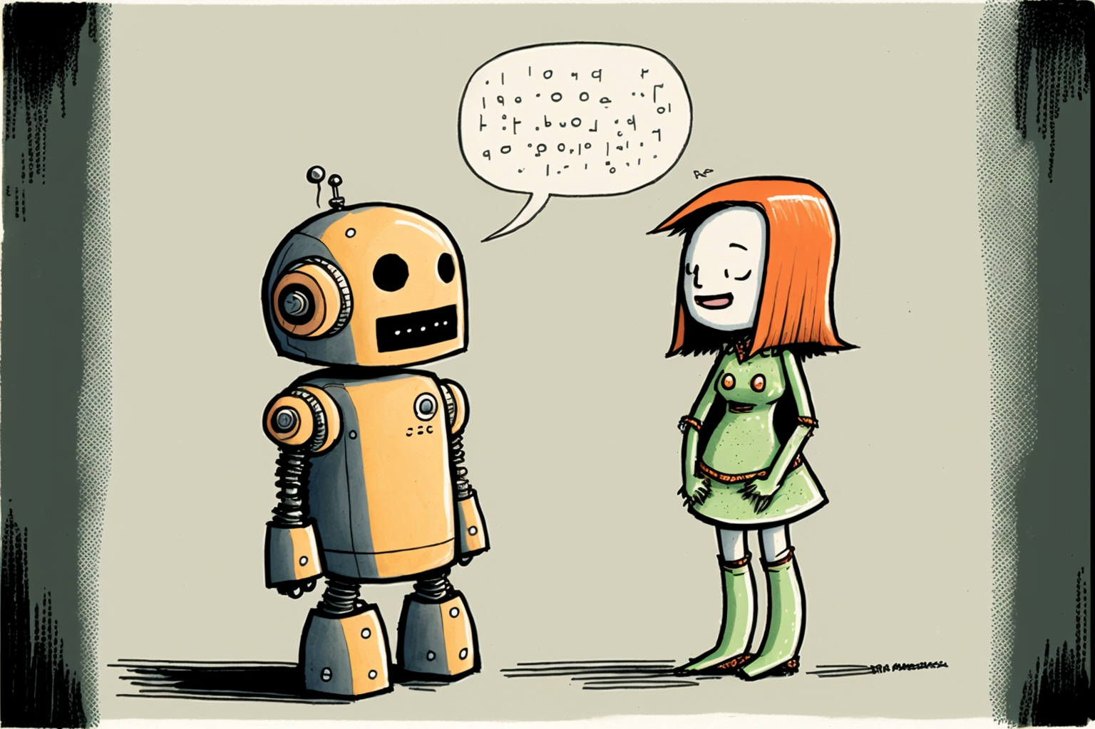
Talking to ChatGPT & Forming An Effective Prompt
Use a single thread for related topics
ChatGPT will do what you ask even if it doesn’t know enough to do it. So you should starts tasks with, “I would like you to ask me everything you need to know to completely and effectively ….. <YOUR TASK HERE>”
Provide feedback and be ready to ask ChatGPT to try again.
A big complaint with ChatGPT is that it is too verbose before getting to the point. If you get a response that you don’t like, you can refine it with a prompt like this, “Can you revise that for me to be more concise and less flowery in the way you say it, without losing any of the meaning or details?”

Slide 24
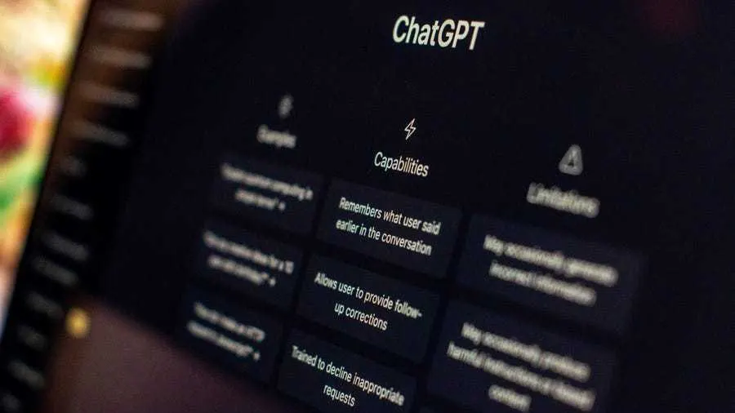
Some things you can do with ChatGPT
Create a hiring strategy based on the types of employees you are hiring
Create, refine or optimize your job descriptions
Write mission, vision and values statements
Create a newsletter or other retention materials
Get advice based on specific topics or issues
Brainstorm ideas
Create step by step plan

Slide 25
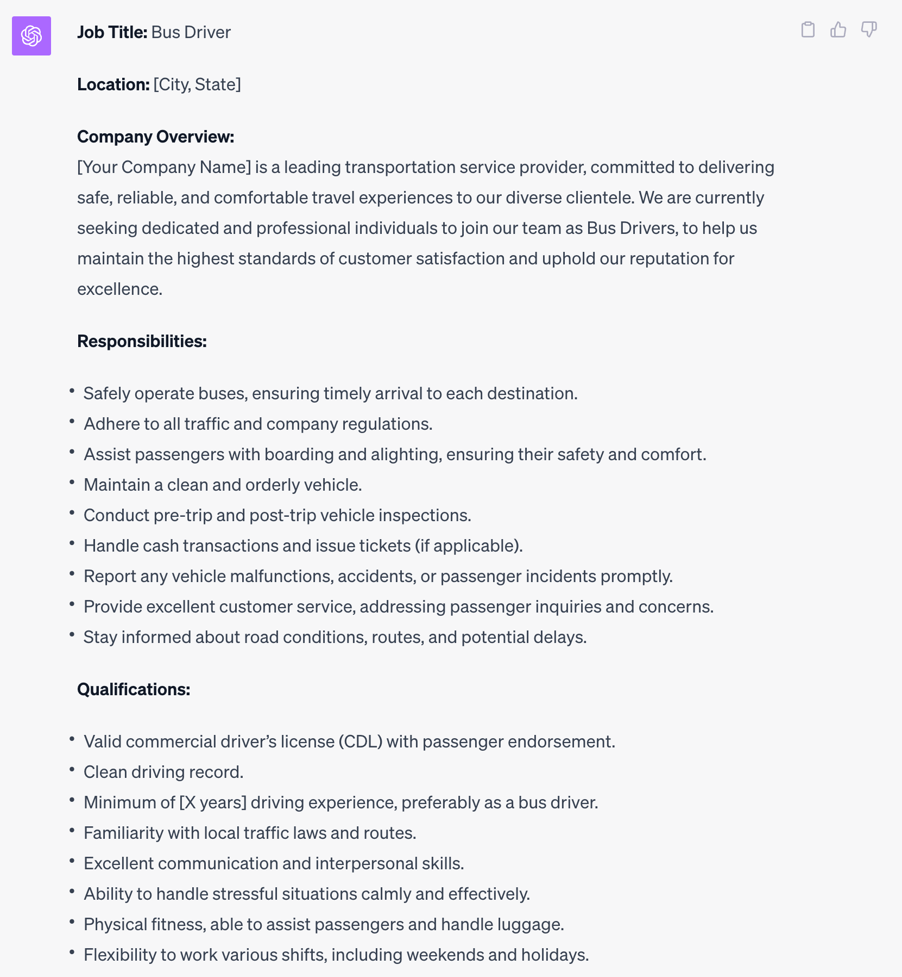
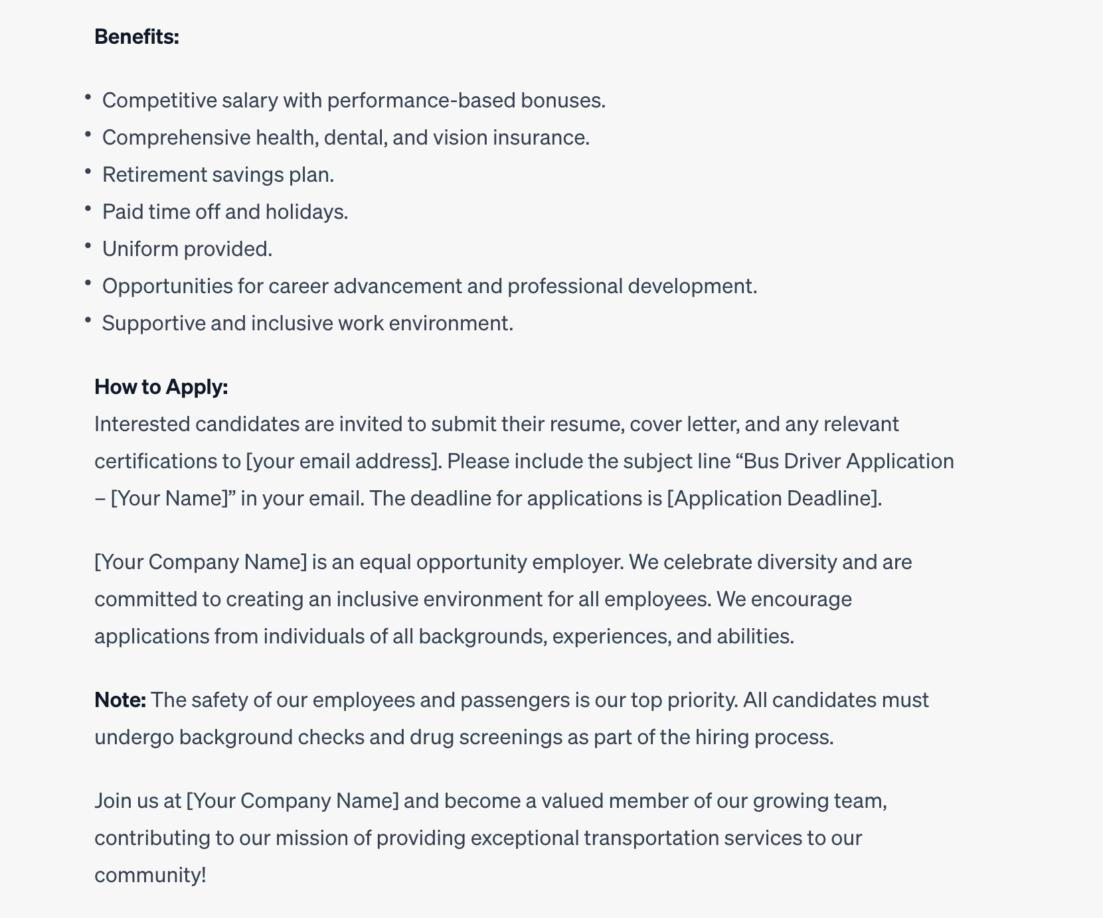
Create an effective and compelling job description that will help me recruit new drivers for my bus company.

Slide 26
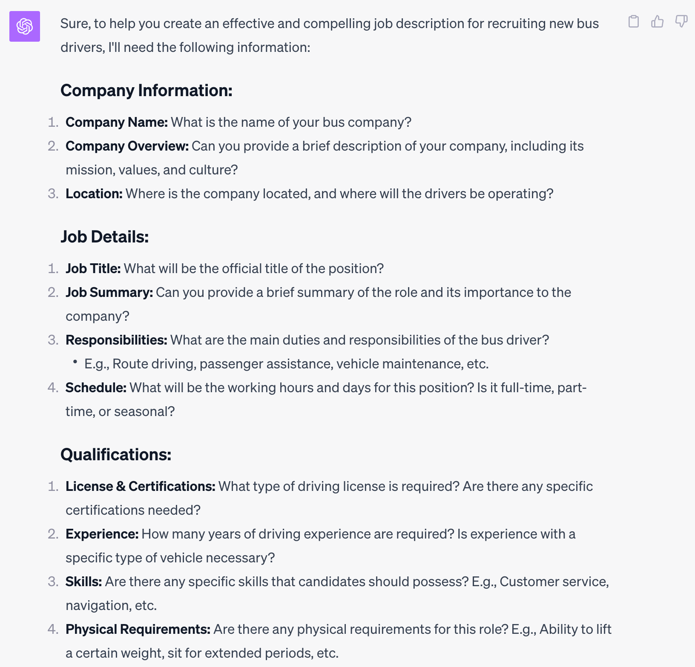
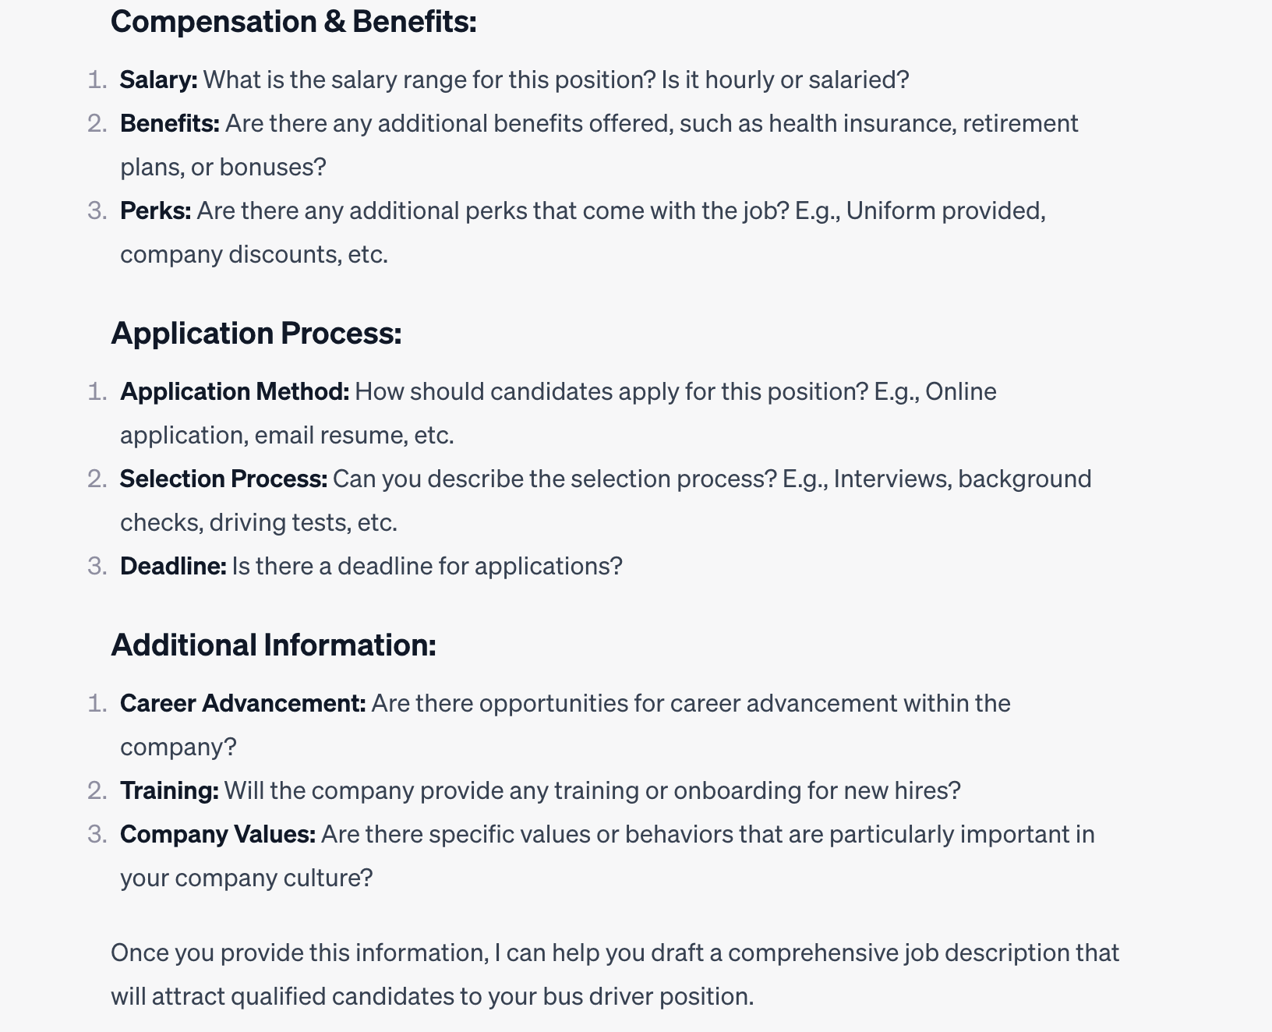
I would like you to ask me everything you need to know to completely and effectively create an effective and compelling job description that will help me recruit new drivers for my bus company.

Slide 27
Chat GPT- Prompts
Job Descriptions Example
I would like you to ask me everything you need to know to completely and effectively create an effective and compelling job description that will help me recruit new drivers for my bus company.
We currently use this job description “<INSERT HERE>”. Can you tell me what people looking for a CDL driving job are likely to think about this job description and how it presents the company? Do you have any questions for me that would enable you to help me optimize this job description?

Slide 28
Chat GPT- Prompts
Value / Mission Statement
I would like you to ask me everything you need to know in order to help me create a value and mission statement for my company. It is important that mission and values statement reflect who we are and what is important to us, so I would also like any additional recommendations you have for how we can collaborate to create these.

Slide 29
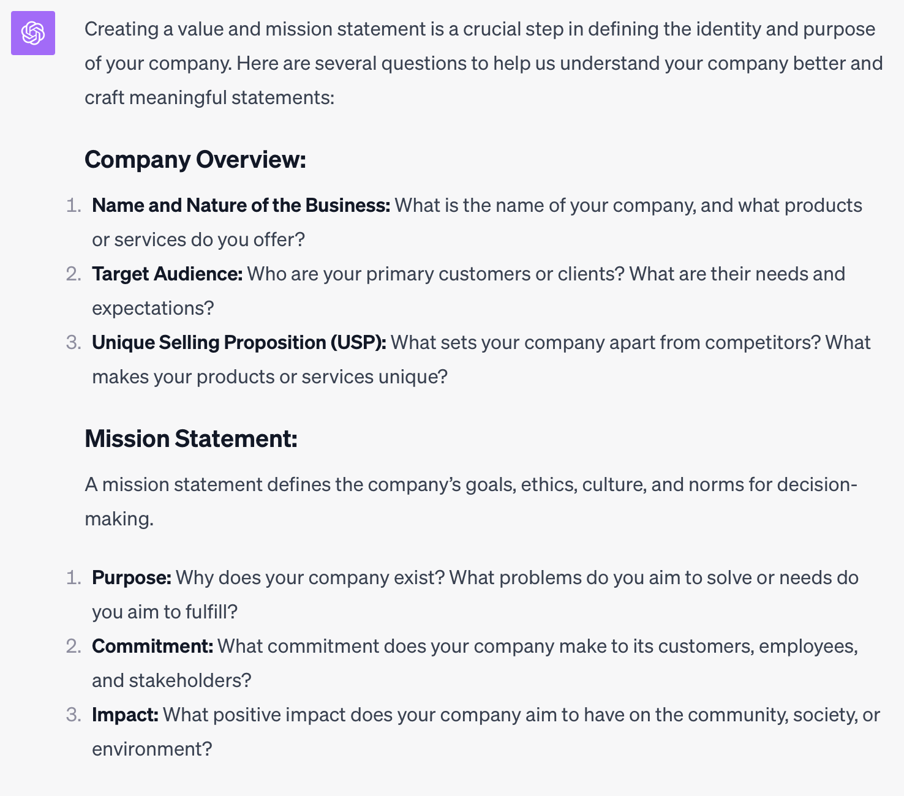
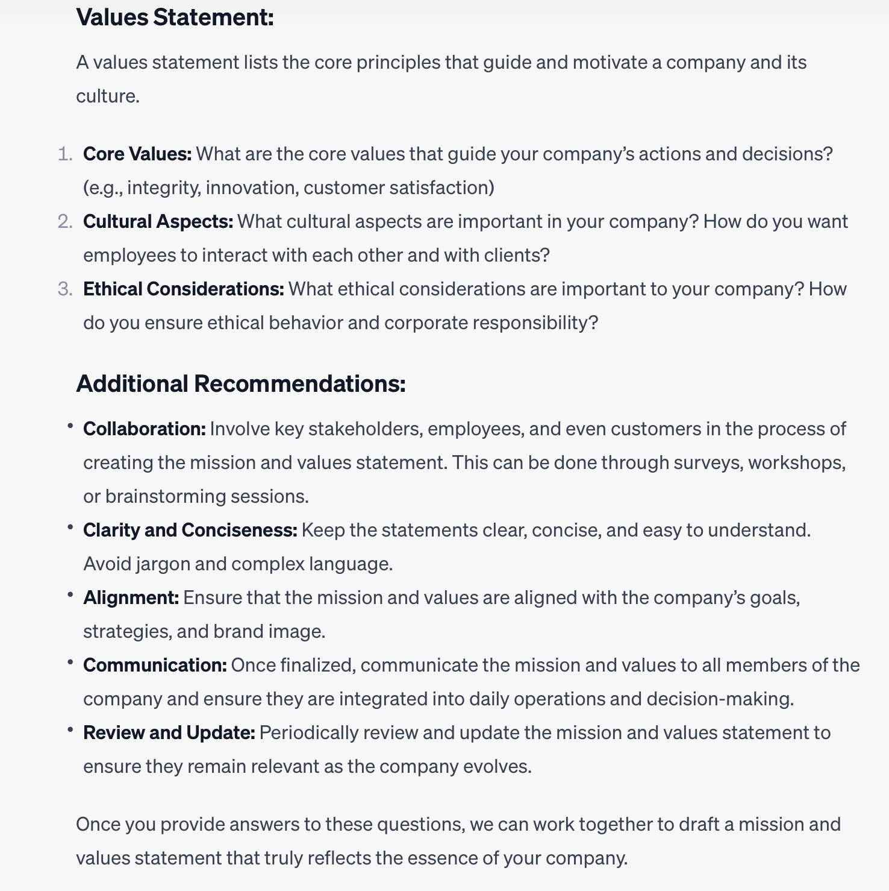
Chat GPT- Prompts

Slide 30
Chat GPT- Prompts
Communicating with drivers- newsletters
My bus company has 20 employee drivers and I would like to create a newsletter for them. What questions do you have for me so you can create an effective and informative newsletter that helps us connect with drivers and keep them informed about what is going on at our company?

Slide 31
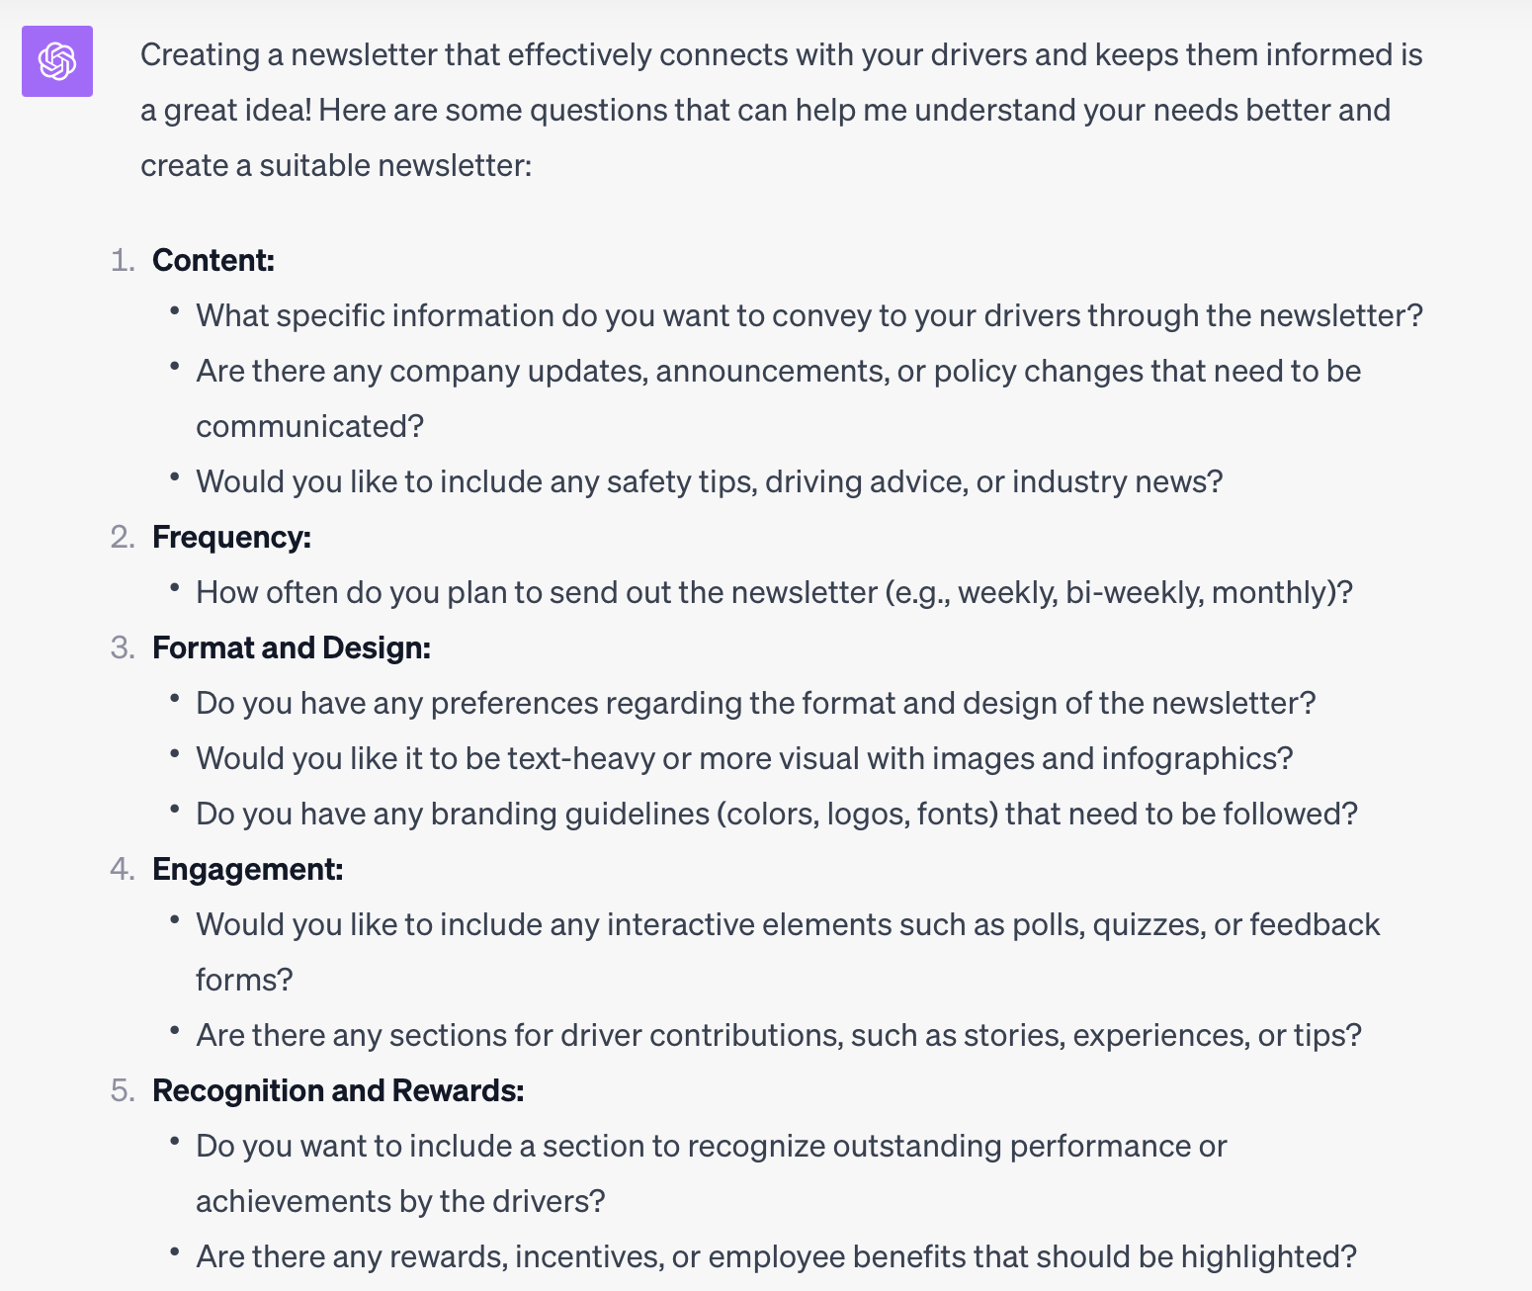
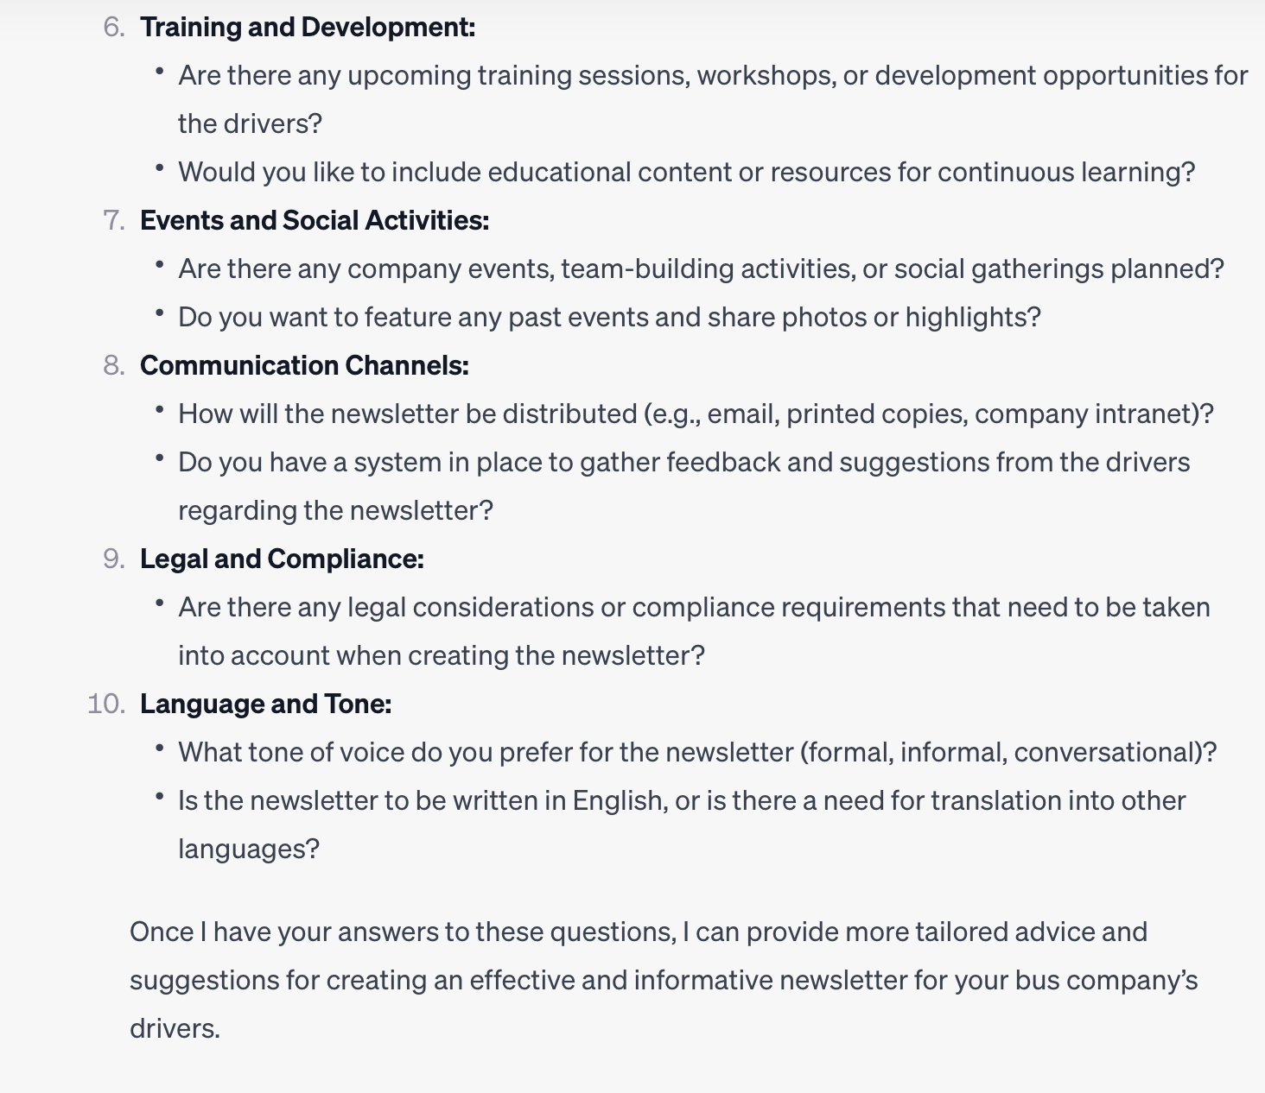
Chat GPT- Prompts

Slide 32
Questions?

Slide 33
To Learn More About The Driving Force Visit
https://www.buses.org/about/drivingforce
Have an idea or want to share feedback?
Email DrivingForce@buses.org
Erin Ducharme educharme@bloombus.com

