Slide 1

Jump Starting/Charging Procedure

Slide 2
Jump Starting/Charging Procedure
“All information provided is intended for informational purposes only and should not be used to replace either technical documents, manuals, guides, manufacturer information or recommendations, nor the advice of a qualified professional. While the information is thought to be accurate on the date it is posted, it is provided on an “as is” basis and without warranty of any kind, either express or implied. In addition, the information may change at any time.”

Slide 3
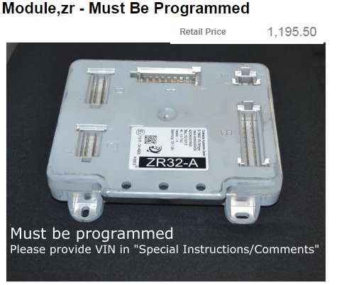
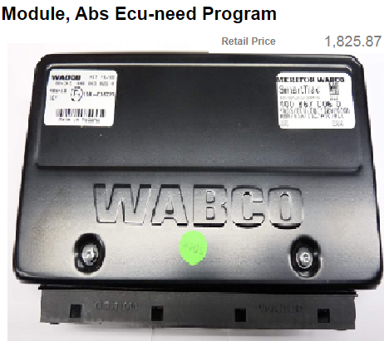

Jump Starting/Charging Procedure
With many coaches being stored for extended periods it may be necessary to jump start your coach.
This procedure will assist technicians in the correct Jump-Starting Procedures.
Not following this procedure can lead to Costly ECU damage.

Slide 4
Safety First
Let’s go through some steps that will help to ensure your personal safety when performing this procedure:
  Park the coach on a level surface with the front wheels straight
  Apply the parking brake and shut down the engine
  Turn off the battery master switch
  Switch off Battery Disconnect switch.(Leave off until coach is charged and ready to start)
  Chock the wheels
  And place a “DO NOT OPERATE” sign on the instrument panel

Slide 5

Jump Starting/Charging Procedure
Before Jump starting your coach it’s a good idea to understand and inspect the equipment you are going to use prior to performing this process.
  Measure the voltage at the rear jump posts or between the ground post and 24-volt stud on the batteries. This voltage should be at least 21.00 volts prior to attempting to starting the vehicle.
  If the voltage is below this level it will be necessary to charge the coach using a battery charger or another vehicle until the voltage level is able to maintain at least 21.00 volts with the charger or second vehicle disconnected.
Charge batteries before starting.

Slide 6
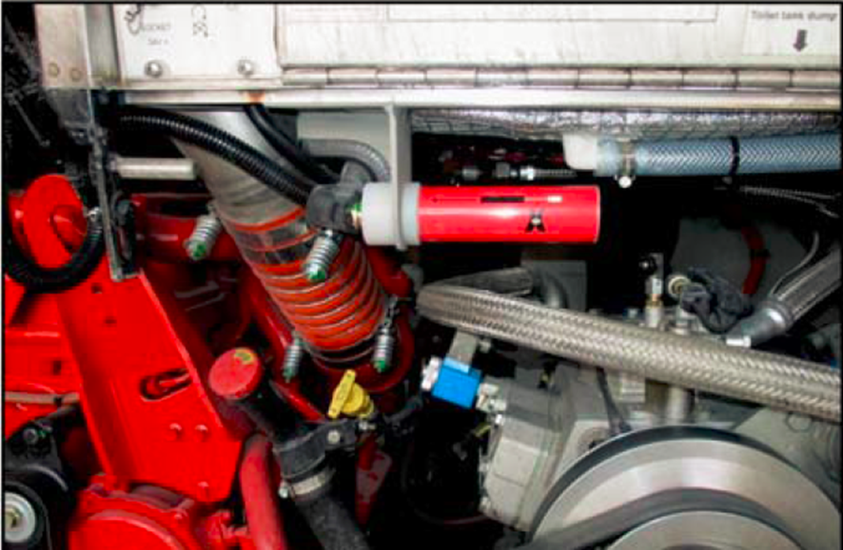
Jump Starting/Charging Procedure
Coach: If a 2nd coach is being used, it’s a good idea to check the charging and battery system of the coach to make sure it’s in good operation. (you don’t want to have 2 down vehicles)
  Inspect Jump posts for corrosion or damage and looseness. If any Damage or corrosion exist this must be repaired before moving on.

Slide 7
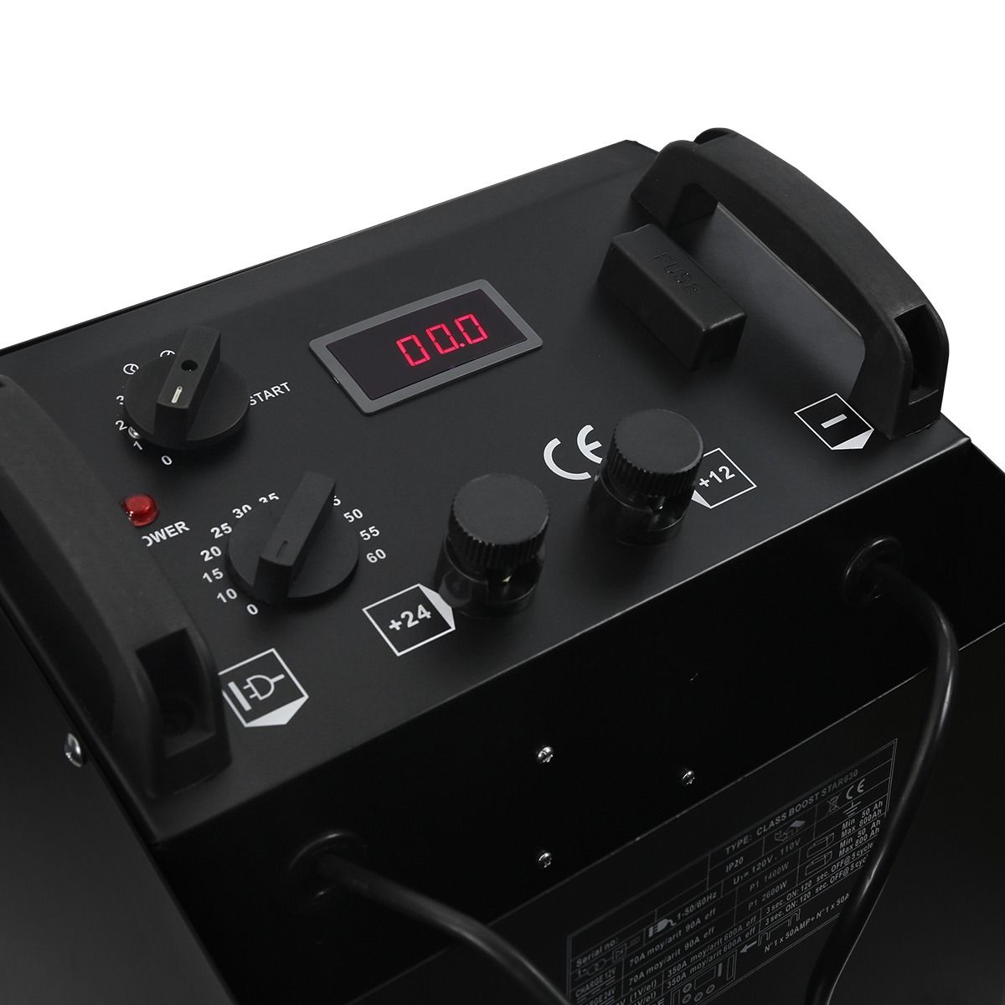
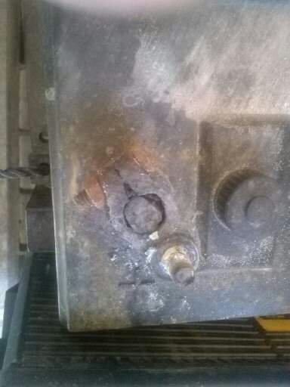
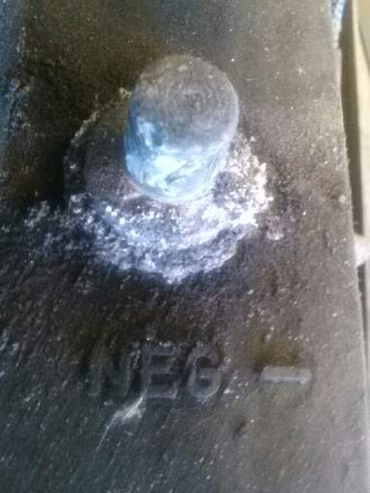
Jump Starting/Charging Procedure
Battery Charger: Check the voltage ratings of the device. If charging batteries individually use 12 volts. If using from rear Jump posts use 24 volts.
Inspect the coach batteries and connections ensure they are clean and tight. Check battery fluid levels.

Slide 8
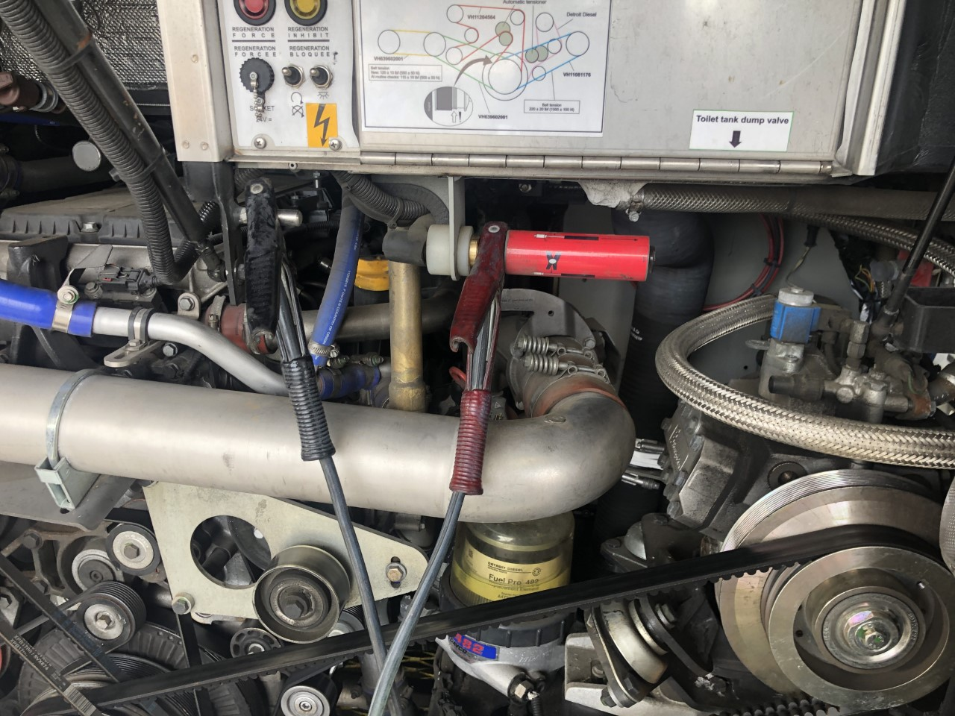
Coach to Coach jump Start
Hook up Positive jumper cable to the Positive jump post of the low voltage coach.
Next hook the other Positive cable to the Positive Jump post to the Host coach.
Hook up Negative jumper cable to the Negative jump post of the low voltage coach.
Next hook the other Negative cable to the Negative Jump post to the Host coach.
Start the host coach. Allow the host coach to run until the depleted batteries have charged to a minimum of 21 Volts. This may take 15 or more minutes depending on how low the batteries are.

Slide 9
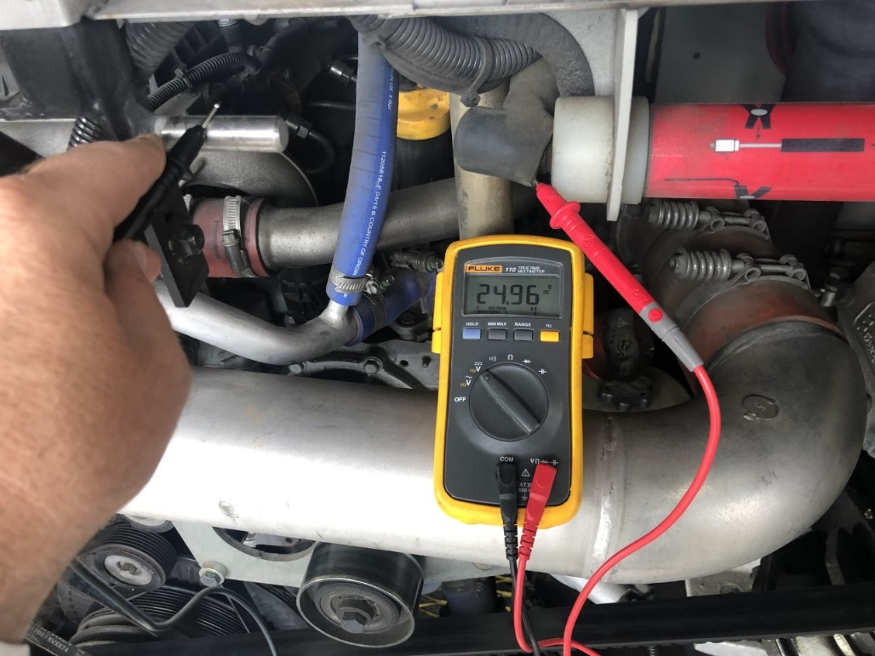
Coach to Coach jump Start
Do not Power up the Coach with Depleted Batteries until a minimum of 21 volts is seen at the jump posts with cables disconnected. Or Damage can occur.
Once battery voltage has been reached start the coach. Leave cables installed to stabilize the charging system.
Once system is stabilized and batteries are charging remove cables in Reverse order Starting with Negative cable from Host coach and so on. Do not let the cables touch anything or each other or damage can happen.

Slide 10
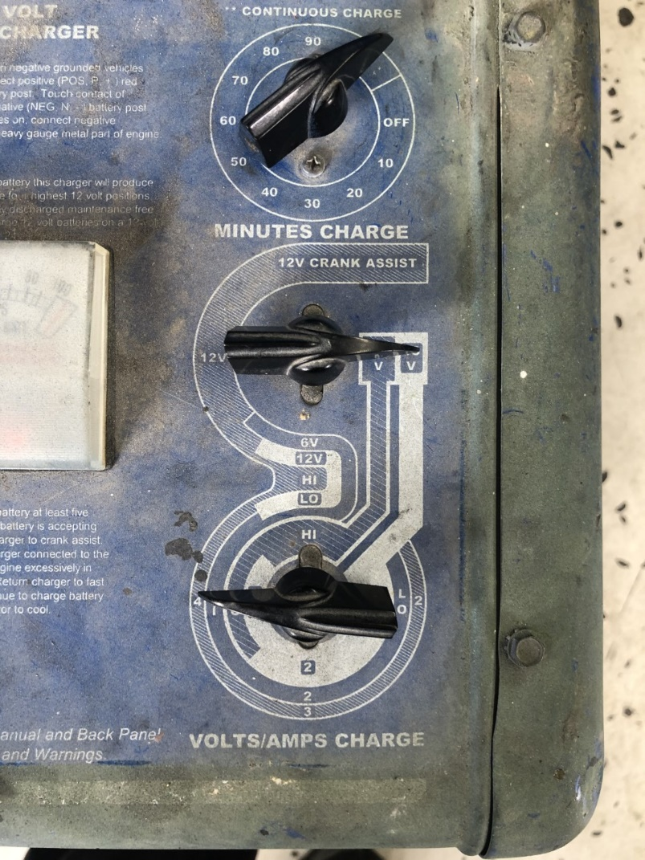
Battery Charger to Coach Jump Start
Hook up Positive jumper cable to the Positive jump post of the coach.
Hook up Negative jumper cable to the Negative jump post of the coach.
Turn on the Battery Charger (Lowest Setting). Allow the charger to run until the depleted batteries have charged to a minimum of 21 Volts. This may take 15 or more minutes depending on how low the batteries are.

Slide 11
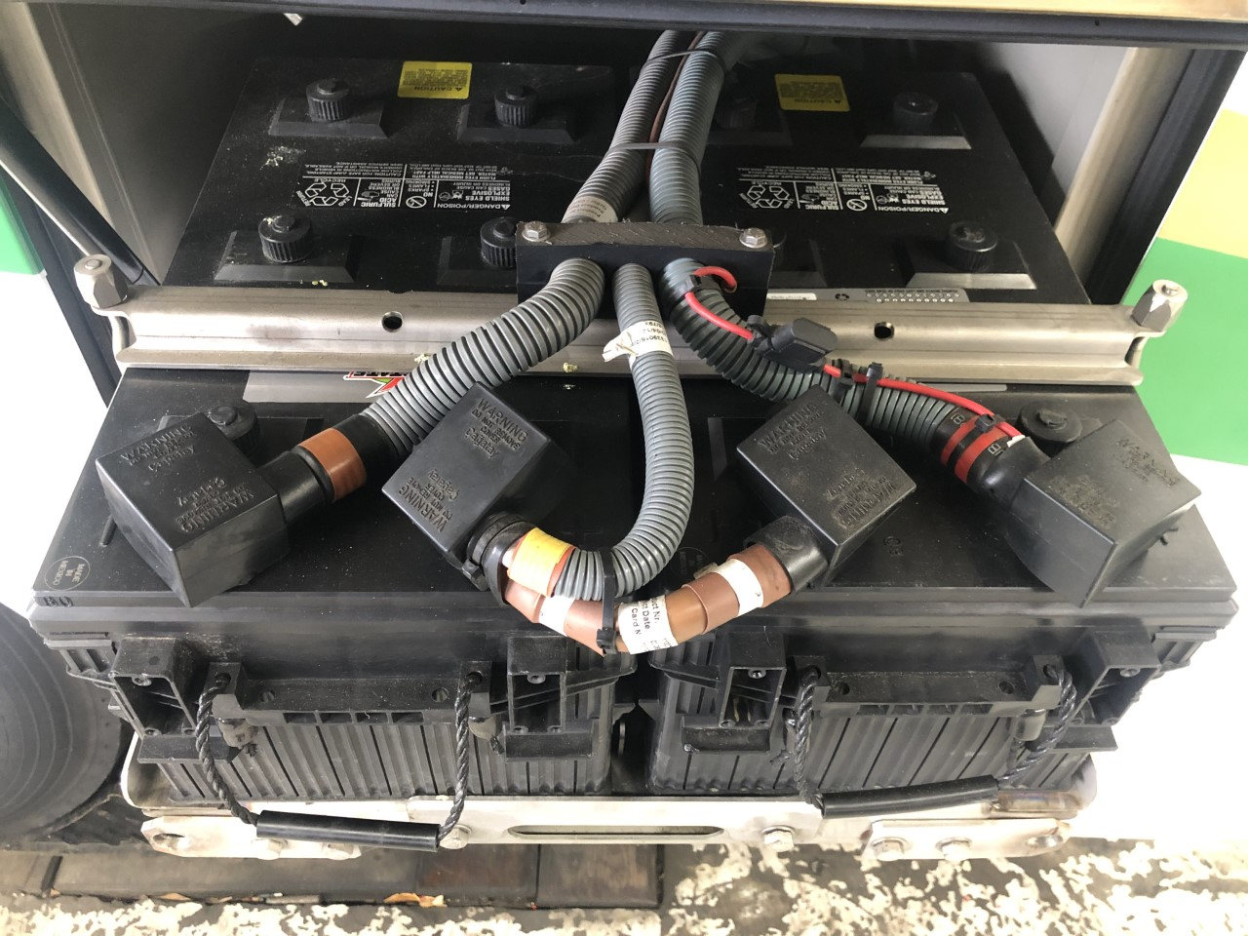
Battery Charger to Coach Batteries
Take a picture of how cables are hooked to the batteries. Or draw a cable layout.
Remove all cables from the batteries
Hook up Positive cable to the Positive post of the battery to be charged.
Hook up Negative cable to the Negative post of the battery to be charged.
Turn on the Battery Charger to lower 12-volt amp rating to allow a slow charge. Allow the charger to charge until the depleted battery has charged to ­­­12.2 Volts. This may take a while depending on how low the batteries are.

Slide 12
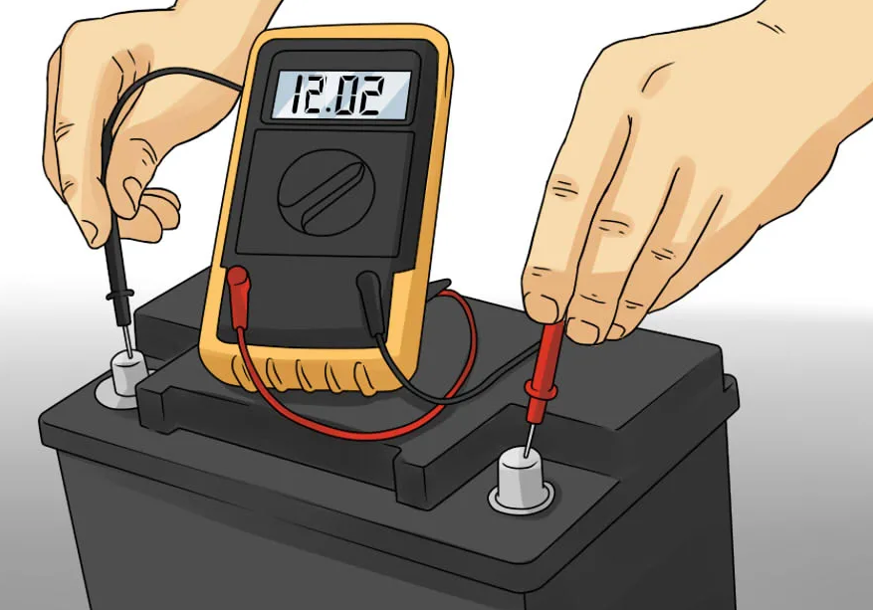
Battery Charger to Coach Batteries
Do not Power the Coach on with Depleted Batteries until this minimum voltage has been reached on both batteries. Or Damage can occur.
Once battery voltage has been reached move to next battery for charging if doing 1 battery at a time.
Once batteries are charged turn off Battery charger and remove cables in Reverse order Starting with Negative cable.
Reinstall battery cables correctly. If you are unsure how to reinstall STOP. Call ABC Tech Support for help.

Slide 13
Battery cable hook up for Van hool coaches
T 2140/45

Slide 14
Battery cable hook up for Vanhool coaches
C2045

Slide 15
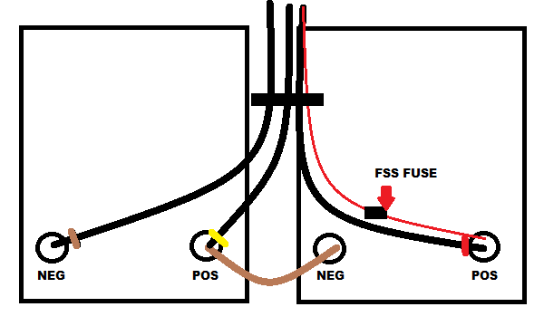
Battery cable hook up for Vanhool coaches
CX45 & CX35
C2045
FSS Fuse
24v Neg
12v Pos
12v Neg
24v Pos

Slide 16
Battery cable hook up for Vanhool coaches
TX
C2045
FSS Fuse
24v Neg
12v Pos
12v Neg
24v Pos

Slide 17


For questions regarding this webcast
please contact
ABC’s Technical Service Department
at 877.427.7278.
Listen for the prompts for Coach Technical Support, and select the
appropriate option. Support is available at this number 24/7.
> Rate This Webinar

