Slide 1
Grants Management
Post Award Orientation for Intercity Bus Security Grant Program Stakeholders
September 2022
Federal Emergency Management Agency
Grant Programs Directorate (GPD)
FEMA's participation in this webinar hosted by the ABA is not an endorsement of the ABA. FEMA's role is to provide education to our IBSGP stakeholders.
Notes:
Provide the focus of the webinar.
Let’s plan to look at the title slide. Tweak as necessary.

Slide 2
FEMA Grant Process Overview
Program Development and Eligibility
Application Submission and Review
Award Determinations and Obligation
Program Implementation and Management
Evaluation and Closeout
Appropriation is enacted
Notice of Funding Opportunity/ Program Guidance Development
Risk Allocation Determination (if applicable)
Grant Solicitation Posted
Grant Rollout
Application Submission
Application Review
Final Award Determinations
Develop Award Package
Congressional Notification
Recipient Notification of Award
Federal Funding Obligated in the FEMA Financial System
Recipient Implements Approved Projects
Funding Available to Recipient through Payment Requests
Programmatic and Financial Reporting
Grant Amendments Requested/ Approved
Strategic and Financial Monitoring
Evaluation and Feedback
Final Progress and Financial Status Reports
Grant Closeout

Slide 3
Non-Disaster Grant Programs
Headquarters (HQ)-managed Grant Programs include:
Assistance to Firefighters Grant (AFG) Program
Homeland Security Grant Program (HSGP)
Tribal Homeland Security Grant Program (THSGP)
Transit Security Grant Program (TSGP)
Intercity Passenger Rail (IPR) Program
Intercity Bus Security Grant Program (IBSGP)
Port Security Grant Program (PSGP)
Regionally-managed Grant Programs include:
Emergency Management Performance Grant (EMPG) Program
National Dam Safety (NDS)
Pre-Disaster Mitigation (PDM)
Community Assistance Program-State Support Services Element (CAP-SSSE)
Regional Catastrophic Preparedness Grant Program
Notes:
Specify that this is not all inclusive.

Slide 4
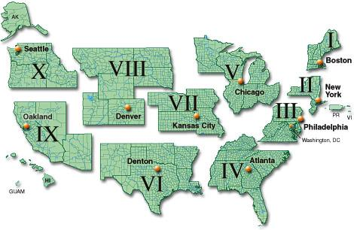
FEMA Regions

Slide 5

Grant Management Journey
Award Terms and Regulations
System Access and Grant Acceptance
Grant Management Checkpoints
Grant Management Responsibilities
Monitoring, Improper Payments
Elimination and Recovery Improvement
Act (IPERIA) and Audits
Closeout
Tools and Helpful Links
Notes:
Agenda slide – Maybe add the term “Non-Disaster Programs”

Slide 6
Award Terms and Regulations

Slide 7

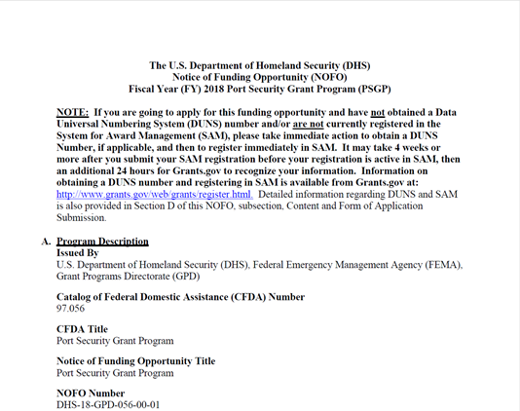
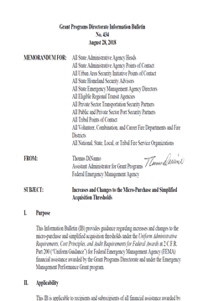
Award Terms and Regulations
2 CFR Part 200
  Uniform Administrative Requirements, Cost Principles, and Audit Requirements for Federal Awards. (https://www.ecfr.gov/cgi-bin/text-idx?tpl=/ecfrbrowse/Title02/2cfr200_main_02.tpl)
Notice of Funding Opportunity/Preparedness Grants Manual
Program-specific guidance and requirements associated with your grant program and grant award
Award Package
    Provides the terms and conditions specific to your Federal award
Information Bulletins
  Administrative instructions and guidelines critical to supporting the effectiveness and efficient delivery of FEMA Grant Programs (Grant Programs Directorate Information Bulletins | FEMA.gov)
  If you would like to be added to the distribution list, email AskCSID@fema.gov
6
Notes:
Background:
The cost principles, administrative requirements, and audit requirements are codified in 2 CFR Part 200.
Audit requirements are contained in 2 CFR 215.26, Non-Federal Audits (formerly OMB Circular A-133).

Slide 8
Know Your Points of Contact
HQ Preparedness Officer- Conducts all programmatic pre-award, award, and post-award activity. Reviews programmatic reports and project activity. Formerly known as Program Analyst.
HQ Grants Management Specialist - Conducts all financial pre-award, award, and post-award grant administration functions not delegated to the Regions.
Regional Program Analyst and Grants Management Specialist - Conducts all financial pre-award, award, and post-award grant administration functions for programs managed in the Regions. Conducts quarterly cash analysis and monitoring activity for most FEMA grant programs.

Slide 9
System Access
and
Grant Acceptance

Slide 10
System Access
  NDGrants
    Ensure Points of Contact are accurate
      Authorized Official receives all notifications
      Reference Tool for NDGrants: https://www.fema.gov/non-disaster-grants-management-system
  Payment and Reporting System (PARS)
    Must Register Twice (Payment Request & Reporting)
    PARS Registration Page: https://isource.fema.gov/sf269/execute/OnlineUserRegistration
  SAM.gov
    Ensure banking and organization information is up-to-date
    Must be active during entire period of performance
  Unique Entity Identifier (UEI)
    Effective April 4, 2022, the Federal Government transitioned from using the Data Universal Numbering System or DUNS number, to a new, non-proprietary identifier known as a Unique Entity Identifier or UEI
    UEI registration information is available on GSA.gov
Notes:
Keep SAM registration active, it’s required. May impact grant action approvals.

Slide 11
Grant Acceptance
All applicant/recipient staff with grant responsibilities should read the:
    Notice Of Funding Opportunity (NOFO)
    Preparedness Grants Manual (PGM)
    Award Package
      Award Letter
      Award Amount & Cost-Share
      Agreement Articles
      Period of Performance
      Approved Projects & Detailed Budget
      Obligation Document
Accept grant in ND Grants
    Acceptance Due Date: Refer to NOFO
    PARS Award Acceptance completed by HQ GMS
Have an internal kick off meeting
    Set realistic project management goals, milestones, and timelines
    Review budget and project goals
Notes:
Terms & Conditions may include items that one wouldn’t generally associate with a grant, such as restrictions on human trafficking and civil rights regulations.

Slide 12
Grant Management Checkpoints

Slide 13
Grant Management Checkpoints
Tips and Key Questions:
Have all projects been approved and fully funded?
Have you received approval of the grant budget or are there funding holds on your grant?
Have you received written Environmental Planning and Historic Preservation (EHP) approval, if applicable, to begin your project(s)?
Have you established written procurement policies and procedures?
Have you established a grant file that is ready for use?

Slide 14
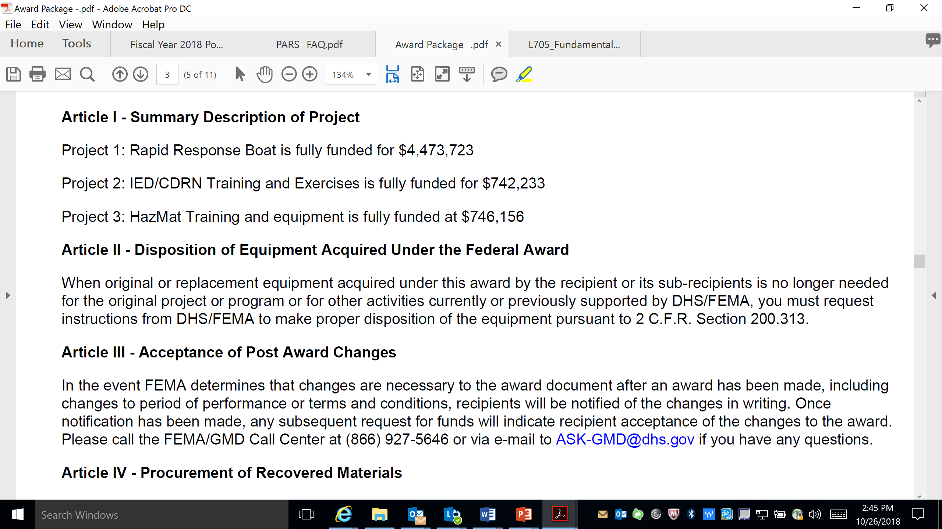
Project Approval
See Summary Description of Project Agreement Article
    Be aware of approved projects and associated funding
Understand the NOFO, PGM and FY 2022 IBSGP Program Priorities
    Protection of Soft Targets/Crowded Places (ST-CPs)
    Cybersecurity (C)
Ensure Budget and Program Office are Engaged

Slide 15
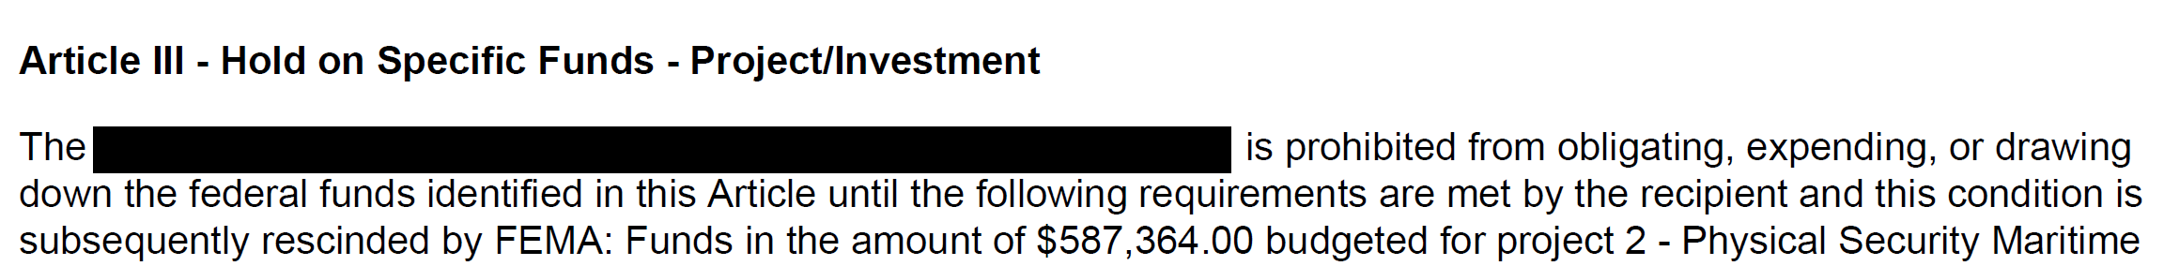
Detailed Budget Approval
Check the award’s Agreement Articles for Hold on Funds Article
    As necessary, work with HQ or Regional GMS to develop an approved Detailed Budget
    Allowable, allocable, reasonable and necessary
    Cost-share source identified?

Slide 16

EHP Compliance
All projects funded with Federal grant dollars (including cost-share items) must comply with EHP laws, regulations, and Executive Orders
    An EHP review is an analysis of pertinent project information to determine whether a project would impact environmental or historical resources
The EHP review must be completed by FEMA’s EHP staff before the grant recipient can initiate any work on the FEMA grant-funded project
    May take 90 days or more to complete the EHP review, depending on the project and the environmental concerns
Grant recipients are responsible for completing the EHP Screening Form and providing all relevant EHP materials to GPD via the EHP Mailbox at GPDEHPinfo@fema.dhs.gov

Slide 17
EHP Compliance
Questions about the process? Ask your FEMA Preparedness Officer or FEMA Program Analyst, or send questions to GPDEHPinfo@fema.dhs.gov
Link to EHP Screening Form and instructions: http://www.fema.gov/media-library/assets/documents/90195
Link to FEMA GPD EHP Policy Guidance – includes information on projects exempt from EHP reviews, updated guidance on previously approved facilities, and other useful information: http://www.fema.gov/media-library/assets/documents/85376
Remember – EHP review must be completed before a project can be started!

Slide 18

Federal Procurement Standards
Procurement rules for FEMA grants under the Uniform Administrative Requirements, Cost Principles, and Audit Requirements for Federal Awards (Uniform Rules)
Uniform Rules codified in full at 2 C.F.R. Part 200, procurement rules at 2 C.F.R. §§ 200.317 - 200.327
Non-Federal entities must review these requirements, as well as the NOFO and PGM
Notes:
The focus of this presentation is the current procurement standards under the Uniform Administrative Requirements, Cost Principles, and Audit Requirements for Federal Awards (Uniform Rules), which are codified at 2 C.F.R. §§ 200.317 through 200.326 and supersede the procurement regulations formerly in effect.
It is also not meant to be an all-encompassing, detailed explanation of every and all requirements. For example, some slides may omit or only summarize certain standards set forth in the regulations.

Slide 19
Grant File Creation
Application
Award Package
Amendments
Performance and Financial
Reports
Expenditure Source Documentation
Policies and Procedures
Indirect Cost Rate Agreements
Audits and Corrective Action Plans (CAP) – must be uploaded to Federal Audit Clearinghouse
Correspondence
Monitoring
Final Application...
Programmatic, Financial…
Expenditure Documentation
Visual 7.21
Notes:
Background:
This slide gives an overview of examples of required documentation for official grant file
For subrecipient awards, each award should have a file containing similar information.
Also, for the pass-through agency, a similar file should be established for the M&A Budget and Expenses.
M&A File will also contain the SF 424 (Application for Federal Assistance), SF425 (Federal Financial Report[s]), monitoring reports from FEMA regions (unless fire program which will be from headquarters), etc.
* 2CFR Part 200 does not specify the exact file format but does in several places describe the records that must be maintained. This slide is one example of what you might expect to see but there are additional administrative and programmatic documentation requirements.
18

Slide 20
Grant Management Responsibilities

Slide 21

Grant Management Tips
Maintain adequate written procedures and policies
Obtain and document EHP Approval
Manage and monitor project activity and progress
Inventory Management
Maintain adequate financial system:
  Clear financial paper trail
  Associate grant expenditures to a specific funding source
  Maintain Source Documentation
  Manage cash effectively
Notes:
Getting started
Getting organized for receipt of Federal funds
Register in Payment and Reporting (PARS)
Program vs. financial—not mutually exclusive
Understanding Federal requirements
Establishing policies and procedures; these are required and will be monitored by funding agency
“Minimum” requirements for financial system
Provide financial/performance data
Associate grant expenditures to specific funding source
Provide clear audit trail
Manage cash effectively
20

Slide 22
Semi-Annual Performance Progress Report (SF-PPR)
System: ND Grants
Requirement:
    Provide a narrative on project progress;
    Summary of project expenditures; and
    Description of any potential issues that may affect project completion
Programmatic Reporting Periods:
    January 1-June 30
    July 1-December 31
Due: No later than 30 days after reporting period end date

Slide 23
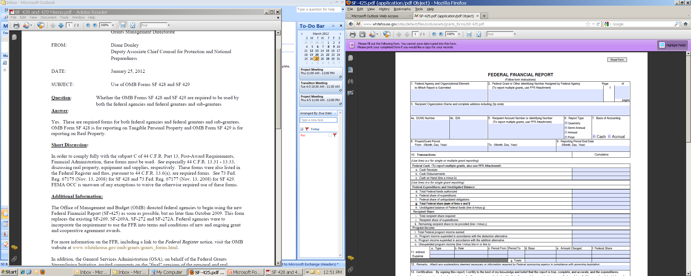
Quarterly Federal Financial Report (FFR)
System: PARS
Requirement: Provide cumulative financial status update on each grant, on a quarterly basis
Reporting Period:
    January 1-March 31
    April 1-June 30
    July 1-September 30
    October 1-December 31
Due: No later than 30 days after reporting
period end date
Specific instructions for each line item of the
report can be found at the following website: Line Item Instructions for the Federal Financial Report (archives.gov)
Notes:
22

Slide 24
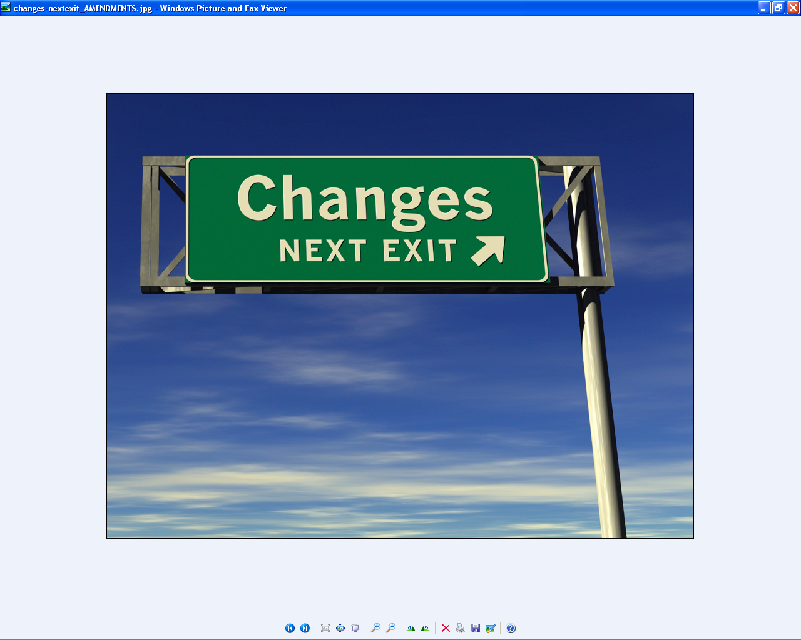
Additional Grant Mgmt. Activities
Payment Request
    Utilize PARS systems to request grant funds
    Ensure proper accounting of drawdown activity
Amendments
    Scope of Work Change
    Budget Changes
    Period of Performance Extension
      Formal request with compelling justification required
    Authorized Official/POC Changes
Grant File Management
    Maintain a complete and accurate Grant File
    Electronic or Paper File is acceptable
Notes:
Amendments are done in each grant program’s respective grant system.

Slide 25
Monitoring, IPERIA
and Audits
Notes:
Specify that we’re talking about FEMA monitoring the recipient.

Slide 26

Types of Monitoring
Monitoring is a partnership, not an audit
Quarterly/Semi-Annual Cash Analysis:
    Internal review of most recent financial report and our Federal financial system
Quarterly/Semi-Annual Performance Report Review:
    Internal review of most recent performance reports
First Line Review:
    Internal risk assessment to determine the need for additional monitoring
Desk Reviews:
    Financial or Programmatic
    Office-based verification of compliance
    Requires documentation submission to Federal reviewer
Site Visits:
    Financial or Programmatic
    On-site direct contact with stakeholders
    Visual review of operations, inventory, procedures, and performance sites
Notes:
Letters and communication will take place before and after.
FLR is done programmatically for 100% of Preparedness Grant Program awards

Slide 27
What is Financial Monitoring?
  Conducted to ensure compliance with applicable Federal grant requirements
  Documents are used to validate expenditures
  Written policies, procedures, and financial reports are reviewed

Slide 28
What is Programmatic Monitoring?
Conducted to ensure recipient accomplishments align with the objectives of the Federal award
Analyzing and resolving issues to ensure compliance with applicable terms and regulations, before they become audit findings
Address concerns or issues that may have impeded progress towards the established goals
    Allows for explanation with problems, delays, adverse conditions, or favorable developments meeting time schedules and objectives

Slide 29
Monitoring: Examples of Required
Documentation
Application
Award Package
Amendments
Performance and Financial Reports
Expenditure Source Documentation
Policies and Procedures
Indirect Cost Rate Agreements
Audit Reports
Notes:
28

Slide 30
Source Documentation Requirements
Accounting records must be supported by:
Cancelled checks/external source (e.g., financial institution)
Time and attendance records
Payroll registers
Receipts
Invoices and purchase orders
Executed contracts (including history of procurement activity)
Travel authorization forms/travel vouchers
Federally approved indirect cost rate agreement
Fringe benefit rate
Inventory records
Notes:
Be mindful of “audit trail”
29

Slide 31
IPERIA
Improper Payments Elimination and Recovery Improvement Act (IPERIA) of 2012
Congressionally mandated assessment of Federal payments
Sample population selected for full assessment
Examples of improper payments include:
  Federal funds go to ineligible recipients
  Recipients receive the incorrect amount of funds
  Payment is made outside the closeout and liquidation period
  Lack of documentation to support the payment
  Recipients use Federal funds in an improper manner
34
Notes:
Background:
A subsequent statute, the Improper Payments Elimination and Recovery Improvement Act of 2012 (IPERIA; P.L. 112-248), signed into law on January 10, 2013, addresses some of the weaknesses in agency improper payment prevention controls and recovery audit programs.
In particular, IPERIA requires agencies to improve the quality of oversight for high-dollar and high-risk programs, and it mandates that agencies share data regarding recipient eligibility and payment amounts.
In addition, IPERIA requires the Office of Management and Budget to examine the rates and amounts of improper payments that agencies covered and establish targets for increasing those amounts.
Source: Congressional Research Service, Improper Payments and Recovery Audits: Legislation, Implementation, and Analysis by Garrett Hatch, Specialist in American National Government, October 18, 2013
Questions:
30

Slide 32
Audit Types
Performance Audits Conducted by the U.S. Government Accountability Office (GAO)
Performance Audits Conducted by Department of Homeland Security’s Office of Inspector General (DHS/OIG)
Audits under the Single Audit Act
    Requirement: For non-Federal entities that expend $750,000 or more of Federal funds in their fiscal year
Notes:
Performance Audits Conducted by the U.S. Government Accountability Office (GAO)
Scope normally focuses on the grant program or FEMA’s management of it, not the recipient’s management of the grant award.
Performance Audits Conducted by Department of Homeland Security’s Office of Inspector General (DHS/OIG)
Scope may focus on FEMA’s management of the grant program, the recipient’s management of the grant award, or both.
Single “A-133” Audits
Conducted by an independent (non-government) auditor in accordance with 2 CFR Subpart F (Sec. 200.500 – 200.520).
Required when $750,000 in all Federal Funds combined are expended within one fiscal year period of the recipient.
This includes all federal funding sources.

Slide 33
Common Audit Findings
  Inadequate written policies and procedures
  Lack of subrecipient monitoring or monitoring plan
  EHP non-compliance
  Procurement issues
Inadequate accounting procedures
Period of Performance expiration
Failure to manage audit results
Inventory management deficiencies
Notes:
Ask supplanting about Mike Stalling

Slide 34
Closeout

Slide 35
Preparing for Closeout
Per 2 CFR §200.343, no later than 120 days after the period of performance end date, the recipient must:
  Submit all financial, performance, and other reports required under the grant
  Liquidate all obligations incurred under the grant
As your grant approaches the period of performance end date:
  Be sure to reconcile all internal accounting, to include a potential final drawdown
  Ensure that all applicable contractors and sub-recipients have been paid
  If applicable, ensure that agreed-upon cost-shares have been satisfied
  Review inventory tracker to ensure that applicable inventory is purchased and properly tracked
  Review grant file to ensure that it is complete and prepared for retention

Slide 36

Final Closeout Package
Final Performance Progress Report
Final Federal Financial Report (SF-425)
Disposition forms SF-428 and/or SF-429 (if applicable)
Other Programmatic Reports based on Terms and Conditions
Grant Closeout
Visual 12.10
Notes:
Background:
The final closeout package must include the follows:
Final Federal Financial Report (FFR). This FFR must not include any unliquidated obligations. This FFR must account for all funds awarded, whether spent or reported as an unobligated balance and agree with the final drawdown report. If the recipient is unable to liquidate valid obligations before the end of the period of performance, the recipient must request in writing no later than 60 days before the end of the period of performance, an extension of the FFR due date, and this must be approved by FEMA.
SF 428 and SF429 to report Tangible Personal Property and Real Property, if applicable.
Final Performance/Progress Report. This is a programmatic report that provides an overall summary of how the grant was administered, how the funds were used to support the goals of the program, and how this aligned with the originally approved application. Details of all the accomplishments throughout the period of performance should be provided in this report.
Questions:
35

Slide 37
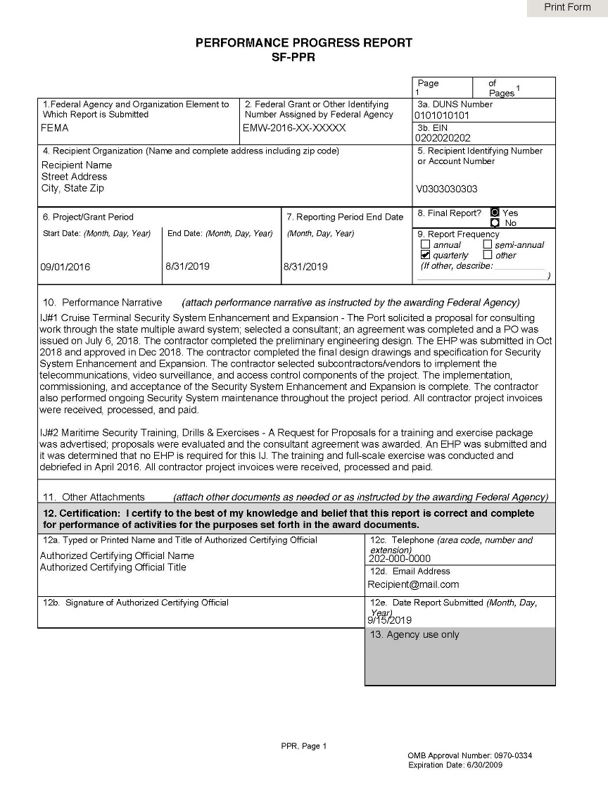
Final Performance Progress Report
Ensure at closeout that the report is marked as final
In the narrative, describe benefits to the program and improved capabilities: tell your story
    By project, as shown in the example
    Attach additional pages, as necessary
Make sure all additional documentation required by the NOFO/PGM is attached
Notes:
In ND Grants

Slide 38
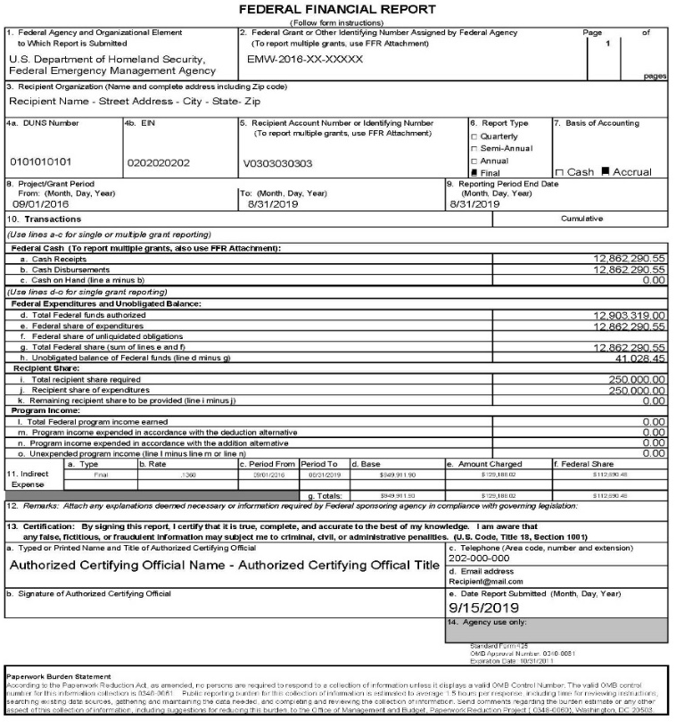
Final FFR SF-425
  Due within 120 days after the period of performance end date or any approved extension date
  Ensure that your report is marked final
  Ensure that there is no Cash on Hand in box 10c
  Ensure there are no unliquidated obligations
  Ensure there are no remaining recipient share (match) to be provided
  Indicate exact balance of unobligated funds
  Indicate final Federal amount charged for indirect costs
  Indicate total program income earned and expended
  Signature of authorized official for Recipient
  Remit check to FEMA for excess funds

Slide 39
Disposition
When original or replacement equipment acquired under a Federal award is no longer needed for the original project or program or for other activities currently or previously supported by a Federal awarding agency, except as otherwise provided in Federal statutes, regulations, or Federal awarding agency disposition instructions, the non-Federal entity must request disposition instructions from the Federal awarding agency if required by the terms and conditions of the Federal award
  SF-428 Tangible Personal Property, if applicable
      Tangible Personal Property means property of any kind, except real property, that has physical existence
      https://apply07.grants.gov/apply/forms/sample/SF428-V1.0.pdf
  SF-429 Real Property Status Report, if applicable
      Real Property means land, including land improvements, structures, and appurtenances thereto, but excludes moveable machinery and equipment
      Post-Award Reporting Forms | GRANTS.GOV
Notes:
Tangible personal property is defined based on the form.
SF428 and SF429 should be included in the Closeout for recipients, when applicable.
If you have acquired Tangible Personal Property with your grant funds, then you are required to report this at Closeout to FEMA using this form
SF 428 - Tangible Personal Property means property of any kind, except real property, that has physical existence
Equipment
Supplies
Does not include
Copyrights, patents or securities
SF-428 and instructions can be found at: http://www.whitehouse.gov/omb/grants_forms/
SF 429 - Real Property means land, including land improvements, structures, and appurtenances thereto, excluding moveable machinery and equipment. (44 CFR Part 13.3)
This form is used to report real property status or to request agency instructions on real property
Questions:

Slide 40
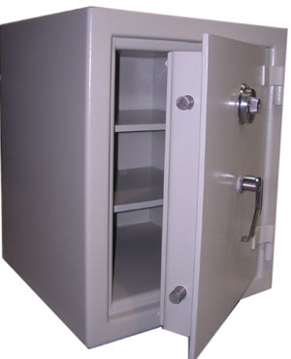
Retention of Records
  Retention of records 2 CFR 200.333-337
  General rule: Three (3) years from the date of submission of final expenditure report as reported to FEMA (or pass-through entity, for subrecipients)
  Exceptions to the general rule include but not limited to: records for real property and equipment must be retained three (3) years after final disposition; records must be retained until resolution of any action such as litigation claim, negotiation, or audit; when the non-Federal entity is notified in writing to extend the period; additional requirements for program income and indirect costs
Non-Federal recipients must also follow their own records retention policies
  Obligation to protect records
  Authorized access to records
Notes:
39

Slide 41
Toolbox Items:
Tools and Helpful Links

Slide 42
Technical Assistance Resources
  Have a need for Technical Assistance?
  GPD Technical Assistance Webpage
  https://www.fema.gov/technical-assistance
  Mini Lessons and Resources
  Grants Management Digital Resource
    https://training.fema.gov/grantsmanagement/
  Email Distribution List: IBs or Federal POC
Contact AskCSID at 1-800-368-6498 or askcsid@fema.gov
Notes:
Background:
Questions:

Slide 43
Preparedness Officer Contacts
David Gronsbell: David.Gronsbell@fema.dhs.gov
States: AL, AR, AZ, CA, CO, DC, FL, IA, IL, IN, KS, KY, LA, MD, ME, MI, MN, MO, MS, NM, OH, SC, TN, VA, VT
Sandra Thurston: Sandra.Thurston@fema.dhs.gov
States: CT, GA, MA, NC, NE, NH, NJ, NV, PA, RI, TX

Slide 44

Questions
FEMA Centralized Scheduling and Information Desk (CSID)
  Phone: 1-800-368-6498
  Email: AskCSID@fema.gov
NDGrants
    Phone: 1-800-865-4076
    Email: NDGrants@fema.dhs.gov
Grants Management Service Desk
  Phone: 1-866-927-5646
  Email: ASK-GMD@dhs.gov
Notes:
Preparedness Officers and GMS are your first and more efficient points of contact when you have a question.

